Slide 1
Relations
Chapter 9
Mr. SHOAIB RAZA

Slide 2
Chapter Summary
Relations and Their Properties
Representing Relations
Equivalence Relations
Partial Orderings

Slide 3
Relations and Their Properties
Section 9.1

Slide 4
Section Summary
Relations and Functions
Properties of Relations
Reflexive Relations
Symmetric Relations
Antisymmetric Relations
Transitive Relations
Irreflexive Relations
Asymmetric Relations
Combining Relations

Slide 5
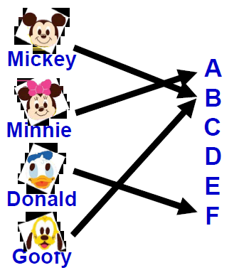
Recall, Function is…
Let A and B be nonempty sets Function f from A to B is an assignment of exactly one element of B to each element of A.
By defining using a relation, a function from A to B contains unique ordered pair (a, b) for every element a ∈ A.

Slide 6
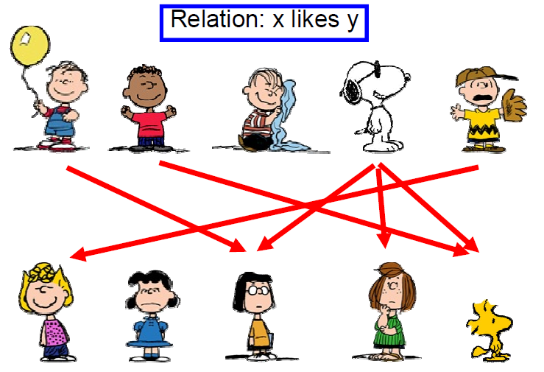
What is Relation?

Slide 7

Binary Relations
Definition: A binary relation R from a set A to a set B is a subset R ⊆ A × B.
Recall, for example:
A = {a1, a2} and B = {b1, b2, b3}
A x B = { (a1, b1), (a1, b2), (a1, b3),
(a2, b1), (a2, b2), (a2, b3)}
Ordered pairs, which
First element comes from A
Second element comes from B
aRb: (a, b) ∈ R
: (a, b) ∉ R
Moreover, when (a, b) belongs to R, a is said to be related to b by R.

Slide 8
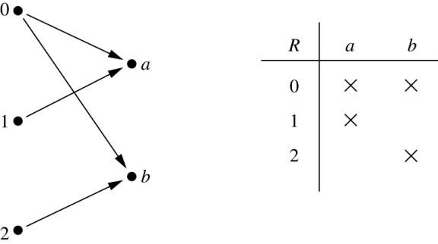
Binary Relations
Example:
Let A = {0,1,2} and B = {a,b}
{(0, a), (0, b), (1,a) , (2, b)} is a relation from A to B.
We can represent relations from a set A to a set B graphically or using a table:

Slide 9
Binary Relations
EXAMPLE:
Let A = {eggs, milk, corn} and B = {cows, goats, hens}
Define a relation R from A to B by (a, b) ∈R iff a is produced by b.
Then R = {(eggs, hens), (milk, cows), (milk, goats)}
Thus, with respect to this relation eggs R hens , milk R cows, etc.

Slide 10
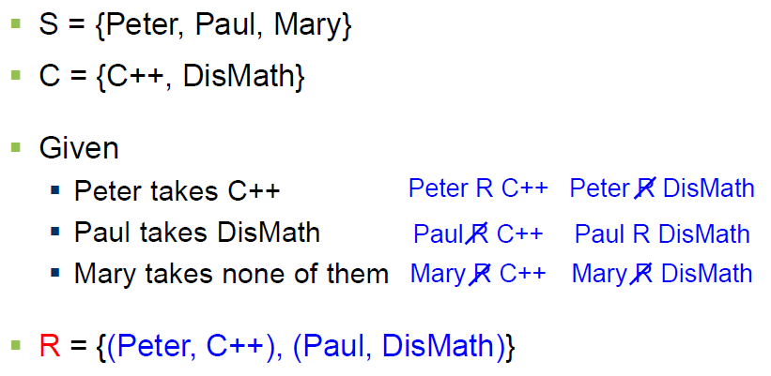
Binary Relations
EXAMPLE #1:

Slide 11
Domain and Range of a Relation
DOMAIN OF A RELATION:
The domain of a relation R from A to B is the set of all first elements of the ordered pairs which belong to R denoted by Dom(R).
Symbolically, Dom (R) = {a ∈A | (a, b) ∈R}
RANGE OF A RELATION:
The range of a relation R from A to B is the set of all second elements of the ordered pairs which belong to R denoted Ran(R).
Symbolically, Ran(R) = {b ∈B | (a, b) ∈ R}

Slide 12
Domain and Range of a Relation
EXERCISE:
Let A = {1, 2}, B = {1, 2, 3},
Define a binary relation R from A to B as follows:
R = {(a, b) ∈A × B | a < b} Then
a. Find the ordered pairs in R.
b. Find the Domain and Range of R.
c. Is 1R3, 2R2?
SOLUTION:
Given A = {1, 2}, B = {1, 2, 3},
A × B = {(1,1), (1,2), (1,3), (2,1), (2,2), (2,3)}
a. R = {(a, b) ∈A × B | a < b}
R = {(1,2), (1,3), (2,3)}

Slide 13
Domain and Range of a Relation
Given A = {1, 2}, B = {1, 2, 3},
A × B = {(1,1), (1,2), (1,3), (2,1), (2,2), (2,3)}
b. Find the Domain and Range of R.
Solution:
Dom(R) = {1,2} and Ran(R) = {2, 3}
c. Is 1R3, 2R2?
Solution:
c. Since (1, 3)∈R so 1R3.
Since (2, 2)∈R so 2R2.

Slide 14
Representing Relations

Slide 15
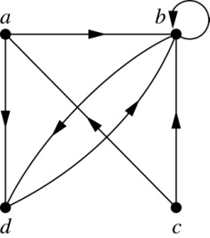
Representing Relations Using Digraphs
Definition: A directed graph, or digraph, consists of a set V of vertices (or nodes) together with a set E of ordered pairs of elements of V called edges (or arcs). The vertex a is called the initial vertex of the edge (a,b), and the vertex b is called the terminal vertex of this edge.
An edge of the form (a,a) is called a loop.
Example: A drawing of the directed graph with vertices a, b, c, and d, and edges (a, b), (a, d), (b, b), (b, d), (c, a), (c, b), and (d, b) is shown here.

Slide 16
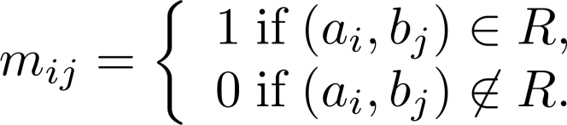
Representing Relations Using Matrices
A relation between finite sets can be represented using a zero-one matrix.
Suppose R is a relation from A = {a₁, a₂, …, a_{m}} to B = {b₁, b₂, …, b_{n}}.
The elements of the two sets can be listed in any particular arbitrary order. When A = B, we use the same ordering.
The relation R is represented by the matrix M_{R} = [m_{ij}], where
The matrix representing R has a 1 as its (i,j) entry when a_{i} is related to b_{j} and a 0 if a_{i} is not related to b_{j}.

Slide 17
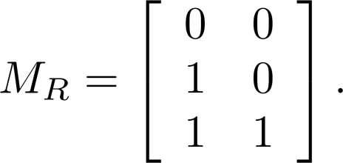
Examples of Representing Relations Using Matrices
Example 1: Suppose that A = {1,2,3} and B = {1,2}. Let R be the relation from A to B containing (a,b) if a ∈ A, b ∈ B, and a > b. What is the matrix representing R (assuming the ordering of elements is the same as the increasing numerical order)?
Solution: Because R = {(2,1), (3,1),(3,2)}, the matrix is

Slide 18
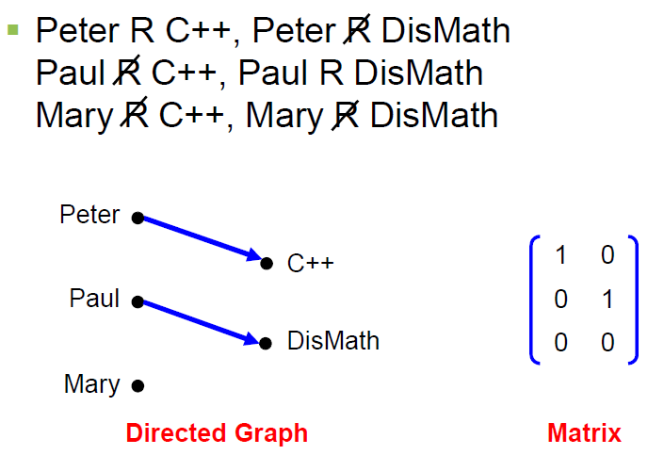
Binary Relations
EXAMPLE #1: (cont.)

Slide 19
Binary Relation on a Set
Definition: A binary relation R on a set A is a subset of A × A or a relation from A to A.
Example:
Suppose that A = {a,b,c}. Then R = {(a,a),(a,b), (a,c)} is a relation on A.
Let A = {1, 2, 3, 4}. The ordered pairs in the relation R = {(a,b) | a divides b} are
{(1,1), (1, 2), (1,3), (1, 4), (2, 2), (2, 4), (3, 3), and (4, 4)}.
REMARK:
For any set A
1. A × A is known as the universal relation.
2. ∅ is known as the empty relation.

Slide 20
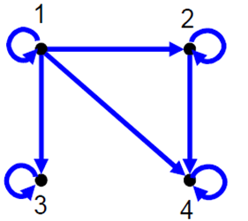
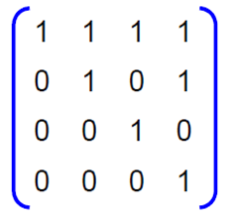
Binary Relation on a Set

Slide 21
Relations and Their Properties

Slide 22
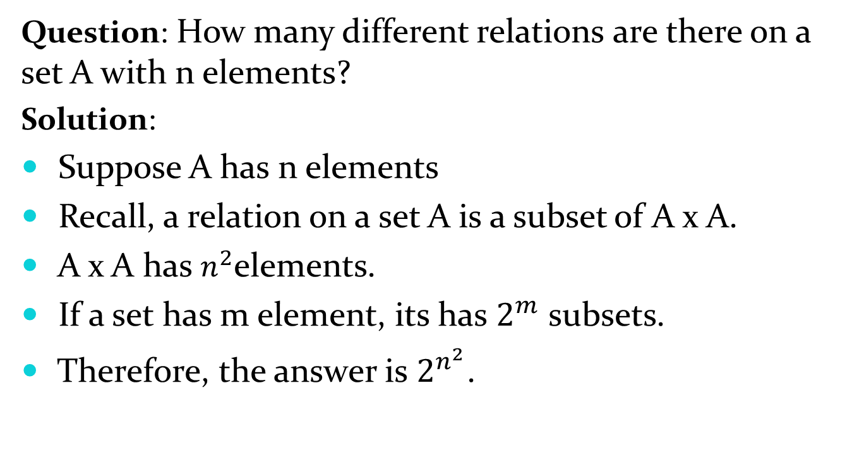
Binary Relation on a Set (cont.)
Question: How many different relations are there on a set A with n elements?
Solution:
Suppose A has n elements
Recall, a relation on a set A is a subset of A x A.
A x A has $n^{2}$elements.
If a set has m element, its has $2^{m}$ subsets.
Therefore, the answer is $2^{n^{2}}$.

Slide 23
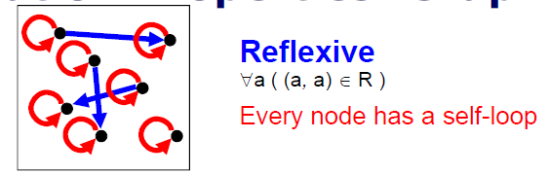
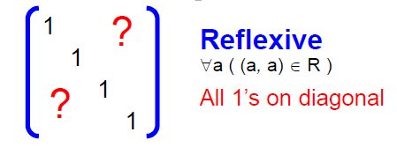
Reflexive Relations
Definition: R is reflexive iff (a,a) ∊ R for every element a ∊ A. Written symbolically, R is reflexive if and only if
∀a[a∊U ⟶ (a,a) ∊ R]
If A = ∅ then the empty relation is reflexive vacuously. That is the empty relation on an empty set is reflexive!

Slide 24
Reflexive Relations
EXAMPLE: Let A = {1, 2, 3, 4} and determine whether relations R1, R2, R3, and R4 are Reflexive?
R1 = {(1, 1), (3, 3), (2, 2), (4, 4)}
R2 = {(1, 1), (1, 4), (2, 2), (3, 3), (4, 3)}
R3 = {(1, 1), (1, 2), (2, 1), (2, 2), (3, 3), (4, 4)}
R4 = {(1, 3), (2, 2), (2, 4), (3, 1), (4, 4)}
Solution:
R1 is reflexive, since (a, a) ∈R1 for all a ∈A.
R2 is not reflexive, because (4, 4) ∉R2.
R3 is reflexive, since (a, a) ∈R3 for all a ∈A.
R4 is not reflexive, because (1, 1) ∉R4, (3, 3) ∉R4.

Slide 25
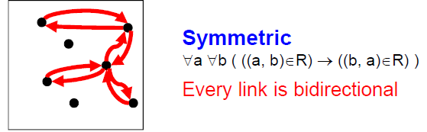
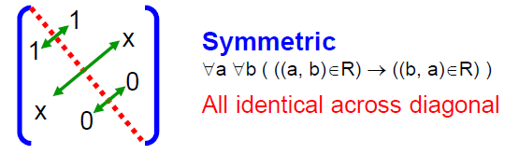
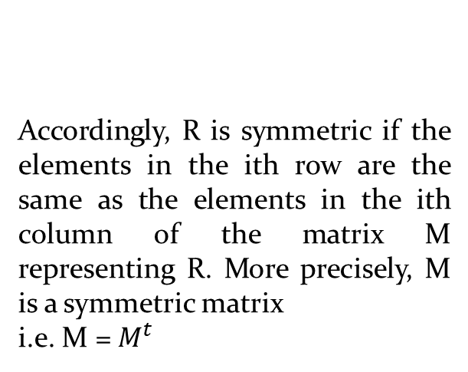
Symmetric Relations
Definition: R is symmetric iff (b,a) ∊ R whenever (a,b) ∊ R for all a,b ∊ A. Written symbolically, R is symmetric if and only if
∀a∀b [(a,b) ∊R ⟶ (b,a) ∊ R]
More precisely, M is a
symmetric matrix i.e. M = Mt
Accordingly, R is symmetric if the elements in the ith row are the same as the elements in the ith column of the matrix M representing R. More precisely, M is a symmetric matrix
i.e. M = $M^{t}$

Slide 26
Symmetric Relations
EXAMPLE: Let A = {1, 2, 3, 4} and determine whether relations R1, R2, R3, and R4 are Symmetric?
R1 = {(1, 1), (1, 3), (2, 4), (3, 1), (4,2)}
R2 = {(1, 1), (2, 2), (3, 3), (4, 4)}
R3 = {(2, 2), (2, 3), (3, 4)}
R4 = {(1, 1), (2, 2), (3, 3), (4, 3), (4, 4)}
Solution:
R1 is Symmetric, since (a, b) and (b, a) ∈R1 for all (a, b) ∈A.
R2 is also symmetric. We say it is vacuously true.
R3 is not symmetric, because (2,3) ∈ R3 but (3,2) ∉ R3.
R4 is not symmetric because (4,3) ∈ R4 but (3,4) ∉ R4.

Slide 27
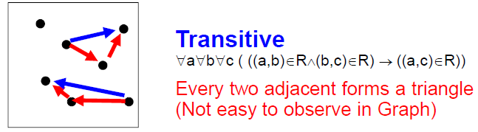
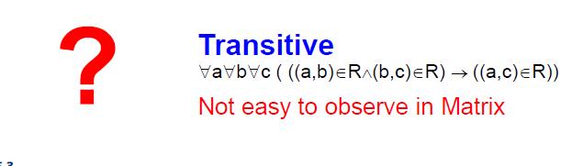
Transitive Relations
Definition: A relation R on a set A is called transitive if whenever (a,b) ∊ R and (b,c) ∊ R, then (a,c) ∊ R, for all a,b,c ∊ A. Written symbolically, R is transitive if and only if
∀a∀b ∀c[(a,b) ∊R ∧ (b,c) ∊ R ⟶ (a,c) ∊ R ]
For a transitive directed graph, whenever there is an arrow going from one point
to the second, and from the second to the third, there is an arrow going directly from the
first to the third.

Slide 28
Transitive Relations
EXAMPLE: Let A = {1, 2, 3, 4} and determine whether relations R1, R2 and R3 are Transitive?
R1 = {(1, 1), (1, 2), (1, 3), (2, 3)}
R2 = {(1, 2), (1, 4), (2, 3), (3, 4)}
R3 = {(2, 1), (2, 4), (2, 3), (3,4)}
Solution:
R1 is transitive because (1, 1), (1, 2) are in R, then to be transitive relation(1,2) must be there and it belongs to R.
R2 is not transitive since (1,2) and (2,3) ∈ R2 but (1,3) ∉ R2.
R3 is transitive.(check by definition)

Slide 29
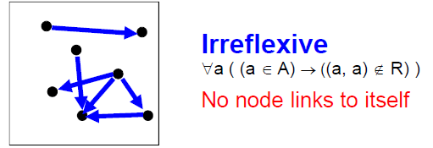
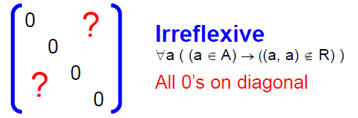
Irreflexive Relations
Definition: R is irreflexive iff for all a∈A,(a,a) ∉R. That is, R is irreflexive if no element in A is related to itself by R.
Written symbolically, R is irreflexive if and only if
∀a [(a ∊A) ⟶ (a , a)∉ R]
R is not irreflexive iff there is an element a∈A such that (a,a) ∈R.

Slide 30
Irreflexive Relations
EXAMPLE: Let A = {1, 2, 3, 4} and determine whether relations R1, R2 and R3 are Irreflexive?
R1 = {(1,3), (1,4), (2,3), (2,4), (3,1), (3,4)}
R2 = {(1,1), (1,2), (2,1), (2,2), (3,3), (4,4)}
R3= {(1,2), (2,3), (3,3), (3,4)}
Solution:
R1 is irreflexive since no element of A is related to itself in R1. i.e. (1,1)∉ R1, (2,2) ∉ R1, (3,3) ∉ R1,(4,4) ∉ R1.
R2 is not irreflexive, since all elements of A are related to themselves in R2.
R3 is not irreflexive since (3,3) ∈R3. Note that R3 is not reflexive.

Slide 31
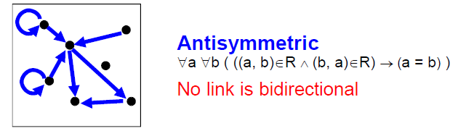
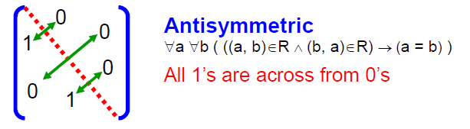
Antisymmetric Relations
Definition: A relation R on a set A such that for all a,b ∊ A if (a,b) ∊ R and (b,a) ∊ R, then a = b is called antisymmetric. Written symbolically, R is antisymmetric if and only if ∀a∀b [(a,b) ∊R ∧ (b,a) ∊ R ⟶ a = b]
Note: (a,a) may be an element in R.
Let R be an anti-symmetric relation on a set A = {a1, a2, …, an}. Then if (ai, aj) ∈R for
i ≠ j then (ai, aj) ∉R.
Thus in the matrix representation of R there is a 1 in the ith row and jth column
iff the jth row and ith column contains 0 vice versa.

Slide 32
Antisymmetric Relations
EXAMPLE: Let A = {1, 2, 3, 4} and determine whether relations R1, R2, R3, and R4 are Antisymmetric?
R1 = {(1,1),(2,2),(3,3)}
R2 = {(1,2),(2,2), (2,3), (3,4), (4,1)}
R3={(1,3),(2,2), (2,4), (3,1), (4,2)}
R4={(1,3),(2,4), (3,1), (4,3)}
Solution:
R1 is anti-symmetric and symmetric.
R2 is anti-symmetric but not symmetric because (1,2) ∈ R2 but (2,1) ∉ R2.
R3 is not anti-symmetric since (1,3) & (3,1) ∈ R3 but 1 ≠ 3. Note that R3 is symmetric.
R4 is neither anti-symmetric because (1,3) & (3,1) ∈ R4 but 1 ≠ 3 nor symmetric because (2,4) ∈ R4 but (4,2) ∉R4.

Slide 33
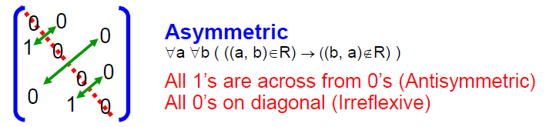
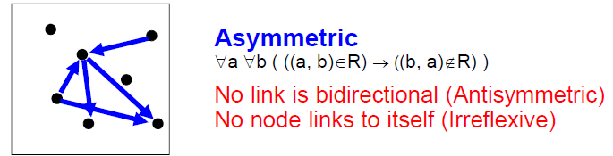
Asymmetric Relations
Definition: R is Asymmetric iff for all (a,b) ∊R than (b ,a)∉R. Written symbolically, R is Asymmetric if and only if
∀a ∀b[((a,b) ∊R)) ⟶ ((b , a)∉ R)]
Note:(a,a) cannot be an element in R.
Asymmetry = Antisymmetry + Irreflexivity

Slide 34
Asymmetric Relations
EXAMPLE: Let A = {1, 2, 3, 4} and determine whether relations R1, R2 and R3 are Asymmetric?
R1 = {(1,1), (1,2), (2,1), (2,2), (3,4), (4,1), (4,4)}
R2 = {(1,2),(2,3),(3,4)}
R3 = {(2,3),(3,3),(3,4)}
Solution:
R1 is not Asymmetric since R1 is neither Antisymmetric nor Irreflexive.
R2 is Asymmetric since R2 is both Antisymmetric and Irreflexive.
R3 is not Asymmetric since it is Antisymmetric but not irreflexive.

Slide 35

Activity Time

Slide 36
Consider the following relations on {1, 2, 3, 4}:
R1 = {(1, 1), (1, 2), (2, 1), (2, 2), (3, 4), (4, 1), (4, 4)},
R2 = {(1, 1), (1, 2), (2, 1)},
R3 = {(1, 1), (1, 2), (1, 4), (2, 1), (2, 2), (3, 3), (4, 1), (4, 4)},
R4 = {(2, 1), (3, 1), (3, 2), (4, 1), (4, 2), (4, 3)},
R5 = {(1, 1), (1, 2), (1, 3), (1, 4), (2, 2), (2, 3), (2, 4), (3, 3), (3, 4), (4, 4)},
R6 = {(3, 4)}.
Determine which of these relation are Reflexive, Symmetric, Transitive, Antisymmetric, Irreflexive and Asymmetric.

Slide 37
Combining Relations
As R is a subsets of A x B, the set operations can be applied
Union (U)
Intersection (∩)
Difference (-)
Symmetric Complement (⊕)
Given two relations R₁ and R₂, we can combine them using basic set operations to form new relations such as R₁ ∪ R₂, R₁ ∩ R₂, R₁ − R₂, R₂ − R₁ and R₁ ⊕ R₂.

Slide 38
Combining Relations
Given, A = {1,2,3}, B = {1,2,3,4}
R1 = {(1,1),(2,2),(3,3)},
R2 = {(1,1),(1,2),(1,3),(1,4)}
R1 U R2 = {(1,1),(1,2),(1,3),(1,4),(2,2),(3,3)}
R1 ∩ R2 = {(1,1)}
R1 - R2 = {(2,2),(3,3)}
R2 - R1 = {(1,2),(1,3),(1,4)}
R1 ⊕ R2 = {(1,2),(1,3),(1,4),(2,2),(3,3)}

Slide 39
Composition of Relations
Definition: Suppose
R₁ is a relation from a set A to a set B.
R₂ is a relation from B to a set C.
Then the composition (or composite) of R₂ with R₁, is a relation from A to C where
if (x,y) is a member of R₁ and (y,z) is a member of R₂, then (x,z) is a member of R₂∘ R₁.

Slide 40
Representing the Composition of a Relation
R₁
R₂
w
m
a
x
n
b
y
o
c
p
z
R₁∘ R₂ = {(b,D),(b,B)}

Slide 41
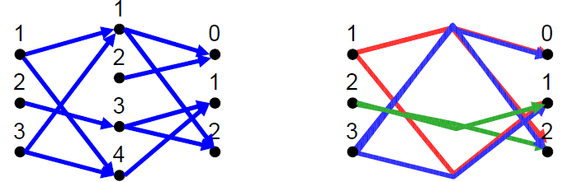
Composition of Relations
What is the composite of the relations R and S, where
R is the relation from {1,2,3} to {1,2,3,4} with
R = {(1,1),(1,4),(2,3),(3,1),(3,4)}
S is the relation from {1,2,3,4} to {0,1,2} with
S = {(1,0),(1,2),(2,0),(3,1),(3,2),(4,1)}?
S o R = {(1,0),(1,2),(1,1), (2,2),(2,1), (3,0),(3,2),(3,1)}

Slide 42
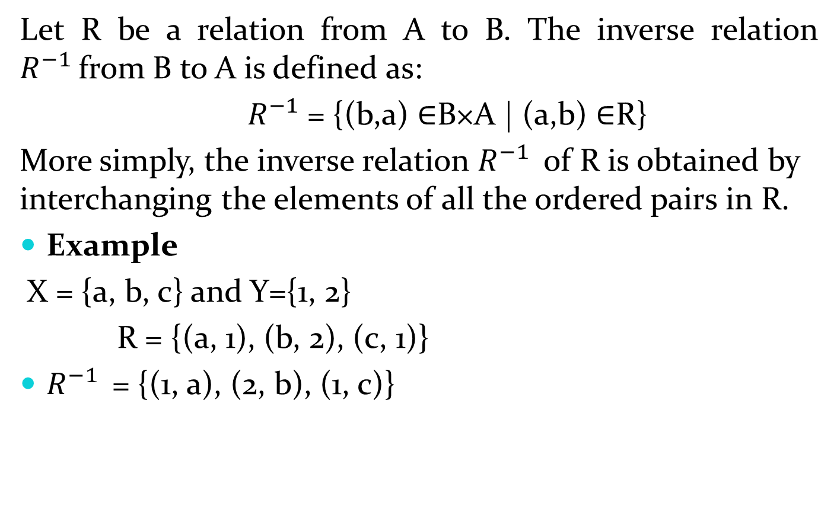
INVERSE OF A RELATION
Let R be a relation from A to B. The inverse relation $R^{−1 }$from B to A is defined as:
${ R}^{−1}$= {(b,a) ∈B×A | (a,b) ∈R}
More simply, the inverse relation $R^{−1 }$of R is obtained by interchanging the elements of all the ordered pairs in R.
Example
X = {a, b, c} and Y={1, 2}
R = {(a, 1), (b, 2), (c, 1)}
$R^{−1 }$= {(1, a), (2, b), (1, c)}

Slide 43
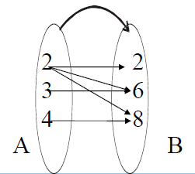
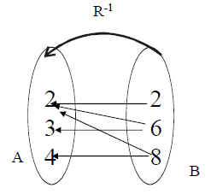
INVERSE OF A RELATION
The relation
R = {(2,2), (2,6), (2,8), (3,6), (4,8)} is represented by the arrow diagram.
Then inverse of the above relation can be obtained simply changing the directions of the arrows and hence the diagram is

Slide 44
Equivalence Relations

Slide 45
Equivalence Relations
Definition 1: A relation on a set A is called an equivalence relation if it is reflexive, symmetric, and transitive.
Definition 2: Two elements a, and b that are related by an equivalence relation are called equivalent. The notation a ∼ b is often used to denote that a and b are equivalent elements with respect to a particular equivalence relation.

Slide 46
Strings
Example:
Suppose that R is the relation on the set of strings of English letters such that aRb if and only if l(a) = l(b), where l(x) is the length of the string x. Is R an equivalence relation?
Solution: Show that all of the properties of an equivalence relation hold.
Reflexivity: Because l(a) = l(a), it follows that aRa for all strings a.
Symmetry: Suppose that aRb. Since l(a) = l(b), l(b) = l(a) also holds and bRa.
Transitivity: Suppose that aRb and bRc. Since l(a) = l(b), and l(b) = l(c), l(a) = l(a) also holds and aRc.

Slide 47
Congruence Modulo m
Example: Let m be an integer with m > 1. Show that the relation
R = {(a,b) | a ≡ b (mod m)}
is an equivalence relation on the set of integers.
Solution: Recall that a ≡ b (mod m) if and only if m divides a − b.
Reflexivity: a ≡ a (mod m) since a − a = 0 is divisible by m since 0 = 0 ∙ m.
Symmetry: Suppose that a ≡ b (mod m). Then a − b is divisible by m, and so a − b = km, where k is an integer. It follows that b − a = (− k) m, so b ≡ a (mod m).
Transitivity: Suppose that a ≡ b (mod m) and b ≡ c (mod m). Then m divides both a − b and b − c. Hence, there are integers k and l with a − b = km and b − c = lm. We obtain by adding the equations:
a − c = (a − b) + (b − c) = km + lm = (k + l) m.
Therefore, a ≡ c (mod m).

Slide 48
Divides
Example: Show that the “divides” relation on the set of positive integers is not an equivalence relation.
Solution: The properties of reflexivity, and transitivity do hold, but there relation is not transitive. Hence, “divides” is not an equivalence relation.
Reflexivity: a ∣ a for all a.
Not Symmetric: For example, 2 ∣ 4, but 4 ∤ 2. Hence, the relation is not symmetric.
Transitivity: Suppose that a divides b and b divides c. Then there are positive integers k and l such that b = ak and c = bl. Hence, c = a(kl), so a divides c. Therefore, the relation is transitive.

Slide 49
Partial Orderings

Slide 50
Partial Orderings
Definition 1: A relation R on a set S is called a partial ordering, or partial order, if it is reflexive, antisymmetric, and transitive.
A set together with a partial ordering R is called a partially ordered set, or poset, and is denoted by (S, R). Members of S are called elements of the poset.

Slide 51
Partial Orderings (continued)
Example 1: Show that the “greater than or equal” relation (≥) is a partial ordering on the set of integers.
Reflexivity: a ≥ a for every integer a.
Antisymmetry: If a ≥ b and b ≥ a , then a = b.
Transitivity: If a ≥ b and b ≥ c , then a ≥ c.
These properties all follow from the order axioms for the integers. (See Appendix 1).

Slide 52
Partial Orderings (continued)
Example 2: Show that the divisibility relation (∣) is a partial ordering on the set of integers.
Reflexivity: a ∣ a for all integers a. (see Example 9 in Section 9.1)
Antisymmetry: If a and b are positive integers with a | b and b | a, then a = b. (see Example 12 in Section 9.1)
Transitivity: Suppose that a divides b and b divides c. Then there are positive integers k and l such that b = ak and c = bl. Hence, c = a(kl), so a divides c. Therefore, the relation is transitive.
(Z⁺, ∣) is a poset.

Slide 53
Partial Orderings (continued)
Example 3: Show that the inclusion relation (⊆) is a partial ordering on the power set of a set S.
Reflexivity: A ⊆ A whenever A is a subset of S.
Antisymmetry: If A and B are positive integers with A ⊆ B and B ⊆ A, then A = B.
Transitivity: If A ⊆ B and B ⊆ C, then A ⊆ C.
The properties all follow from the definition of set inclusion.

Slide 54
Sequences and Series(Sums)

Slide 55
Section Summary
Sequences.
Examples: Geometric Progression, Arithmetic Progression
Recurrence Relations
Example: Fibonacci Sequence
Summations

Slide 56
Introduction
Sequences are ordered lists of elements.
EXAMPLES:
1, 2, 3, 5, 8
1, 3, 9, 27, 81, …….
1, 2, 3, 4, 5, …
4, 8, 12, 16, 20,…
2, 4, 8, 16, 32, …
1, 1/2, 1/3, 1/4, 1/5, …
1, 4, 9, 16, 25, …
1, -1, 1, -1, 1, -1, …
Sequences arise throughout mathematics, computer science, and in many other disciplines, ranging from botany to music.
We will introduce the terminology to represent sequences and sums of the terms in the sequences.

Slide 57
SEQUENCES IN COMPUTER PROGRAMMING:
An important data type in computer programming consists of finite sequences known as one-dimensional arrays; a single variable in which a sequence of variables may be stored.
EXAMPLE:
The names of k students in a class may be represented by an array of k elements “name” as:
name [0], name[1], name[2], …, name[k-1]

Slide 58
Sequences
Definition: A sequence is a function from a subset of the integers (usually either the set {0, 1, 2, 3, 4, …..} or {1, 2, 3, 4, ….} ) to a set S.
The notation a_{n} is used to denote the image of the integer n. We can think of a_{n} as the equivalent of f(n) where f is a function from {0,1,2,…..} to S. We call a_{n} a term of the sequence.
OR
A sequence is just a list of elements usually written in a row.

Slide 59
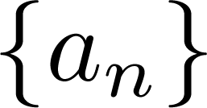
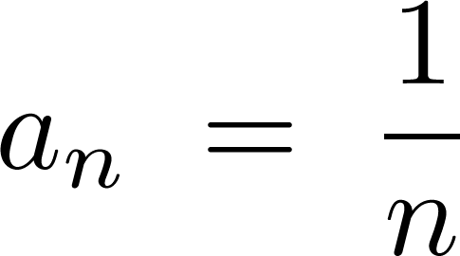
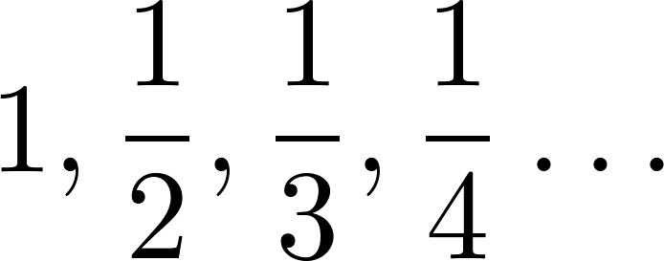
Sequences
Example: Consider the sequence where

Slide 60
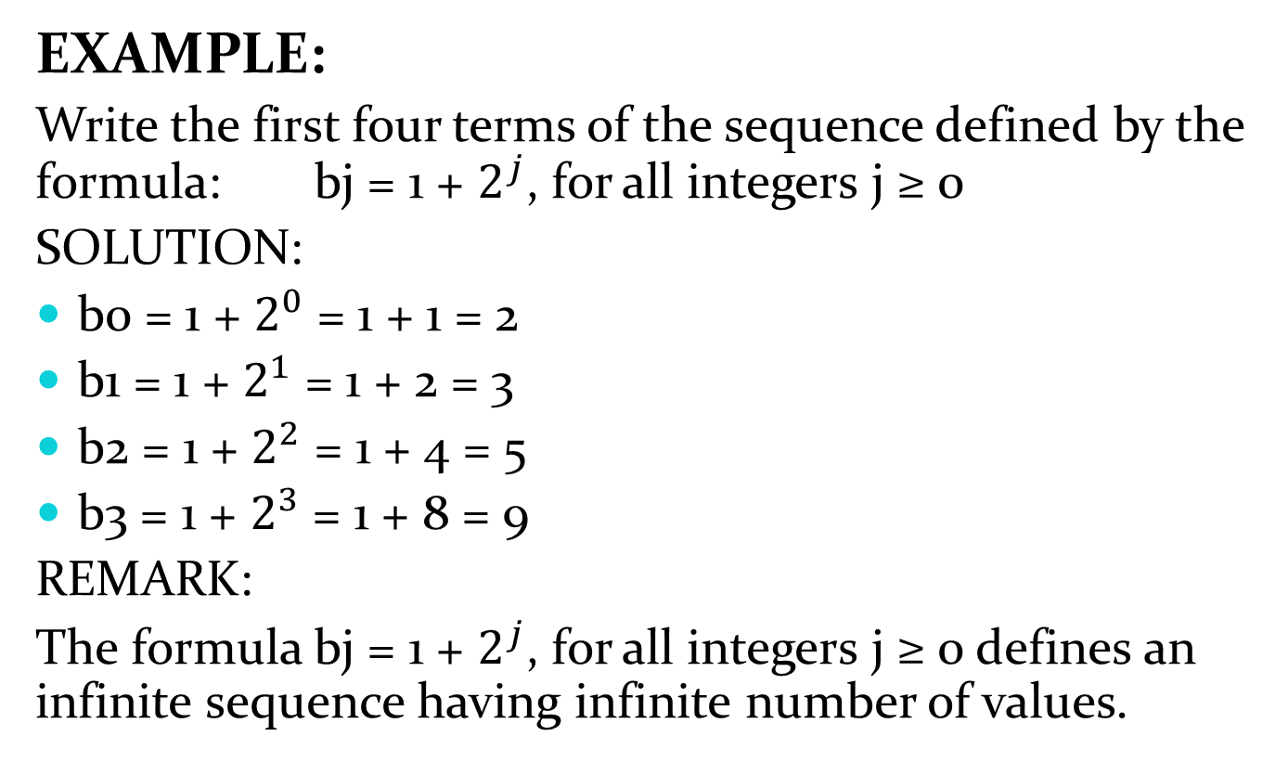
Sequences
EXAMPLE:
Write the first four terms of the sequence defined by the formula: bj = 1 + $2^{j}$, for all integers j ≥ 0
SOLUTION:
b0 = 1 + $2^{0}$ = 1 + 1 = 2
b1 = 1 + $2^{1}$ = 1 + 2 = 3
b2 = 1 + $2^{2}$ = 1 + 4 = 5
b3 = 1 + $2^{3}$ = 1 + 8 = 9
REMARK:
The formula bj = 1 + $2^{j}$, for all integers j ≥ 0 defines an infinite sequence having infinite number of values.

Slide 61
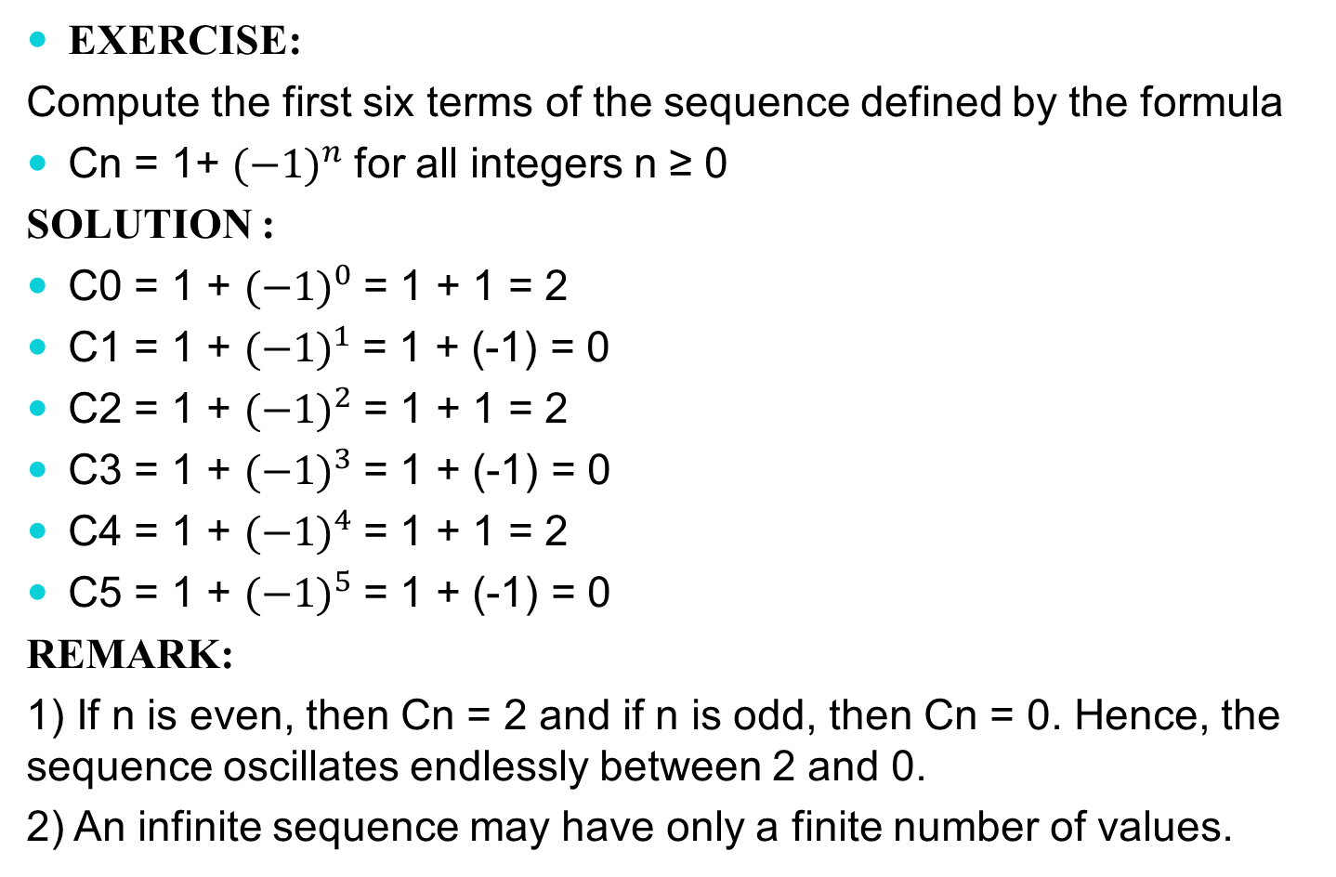
Sequences
EXERCISE:
Compute the first six terms of the sequence defined by the formula
Cn = 1+ ${(−1)}^{n}$for all integers n ≥ 0
SOLUTION :
C0 = 1 + ${(−1)}^{0}$= 1 + 1 = 2
C1 = 1 + ${(−1)}^{1}$= 1 + (-1) = 0
C2 = 1 + ${(−1)}^{2}$= 1 + 1 = 2
C3 = 1 + ${(−1)}^{3}$= 1 + (-1) = 0
C4 = 1 + ${(−1)}^{4}$= 1 + 1 = 2
C5 = 1 + ${(−1)}^{5}$= 1 + (-1) = 0
REMARK:
1) If n is even, then Cn = 2 and if n is odd, then Cn = 0. Hence, the sequence oscillates endlessly between 2 and 0.
2) An infinite sequence may have only a finite number of values.

Slide 62
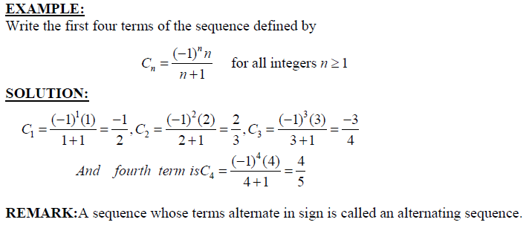
Sequences

Slide 63
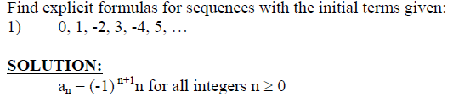
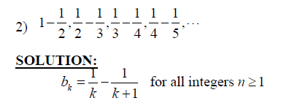
Sequences

Slide 64
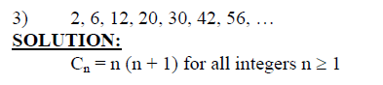
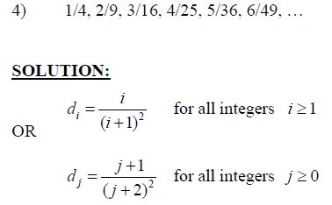
Sequences

Slide 65
Arithmetic Progression OR Sequences
A sequence in which every term after the first is obtained from the preceding term by adding a constant number is called an arithmetic sequence or arithmetic progression (A.P.)
The constant number, being the difference of any two consecutive terms is called the common difference of A.P., commonly denoted by “d”.
EXAMPLES:
1. 5, 9, 13, 17, … (common difference = 4)
2. 0, -5, -10, -15, … (common difference = -5)
3. x + a, x + 3a, x + 5a, … (common difference = 2a)

Slide 66
Arithmetic Sequences
GENERAL TERM OF AN ARITHMETIC SEQUENCE:
Let a be the first term and d be the common difference of an arithmetic sequence. Then the sequence is:
a, a+d, a+2d, a+3d, …
If ai, for i ≥ 1, represents the terms of the sequence then
a1 = first term = a = a + (1-1) d
a2 = second term = a + d = a + (2-1) d
a3 = third term = a + 2d = a + (3 -1) d
By symmetry
an = nth term = a + (n - 1)d for all integers n ≥1.

Slide 67
Arithmetic Sequences
Examples:
Let a = −1 and d = 4:
Let a = 7 and d = −3:
Let a = 1 and d = 2:

Slide 68
Arithmetic Sequences
EXAMPLE:
Find the 20th term of the arithmetic sequence
3, 9, 15, 21, …
SOLUTION:
Here a = first term = 3
d = common difference = 9 - 3 = 6
n = term number = 20
a20 = value of 20th term = ?
Since an = a + (n - 1) d; n ≥1
∴ a20 = 3 + (20 - 1) 6
= 3 + 114
= 117

Slide 69
Arithmetic Sequences
EXERCISE:
Find the 36th term of the arithmetic sequence whose 3rd term is 7 and 8th term is 17.
SOLUTION:
Let a be the first term and d be the common difference of the arithmetic sequence.
Then an = a + (n - 1)d n ≥ 1
⇒ a3 = a + (3 - 1) d and a8 = a + (8 - 1) d
Given that a3 = 7 and a8 = 17. Therefore
7 = a + 2d……………………(1) and 17 = a + 7d………….………..(2)
Subtracting (1) from (2), we get,
10 = 5d ⇒ d = 2
Substituting d = 2 in (1) we have
7 = a + 2(2) which gives a = 3

Slide 70
Arithmetic Sequences
Thus, an = a + (n - 1) d
an = 3 + (n - 1) 2 (using values of a and d)
Hence the value of 36th term is
a36 = 3 + (36 - 1) 2
= 3 + 70
a36 = 73

Slide 71
Geometric Progression OR Sequence
A sequence in which every term after the first is obtained from the preceding term by multiplying it with a constant number is called a geometric sequence or geometric progression (G.P.)
The constant number, being the ratio of any two consecutive terms is called the common ratio of the G.P. commonly denoted by “r”.
EXAMPLE:
1. 1, 2, 4, 8, 16, … (common ratio = 2)
2. 3, - 3/2, 3/4, - 3/8, … (common ratio = - 1/2)
3. 0.1, 0.01, 0.001, 0.0001, … (common ratio = 0.1 = 1/10)

Slide 72
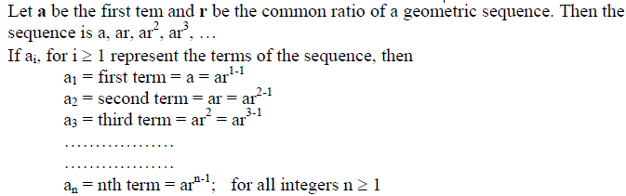
GENERAL TERM OF A GEOMETRIC SEQUENCE:

Slide 73
Geometric Progression
Examples:
Let a = 1 and r = −1. Then:
Let a = 2 and r = 5. Then:
Let a = 6 and r = 1/3. Then:

Slide 74
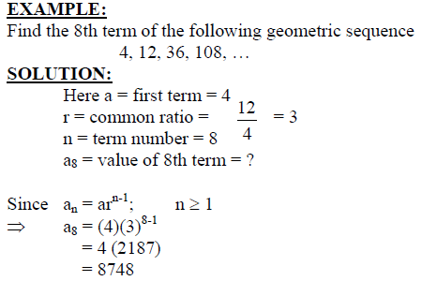
Geometric Sequence

Slide 75
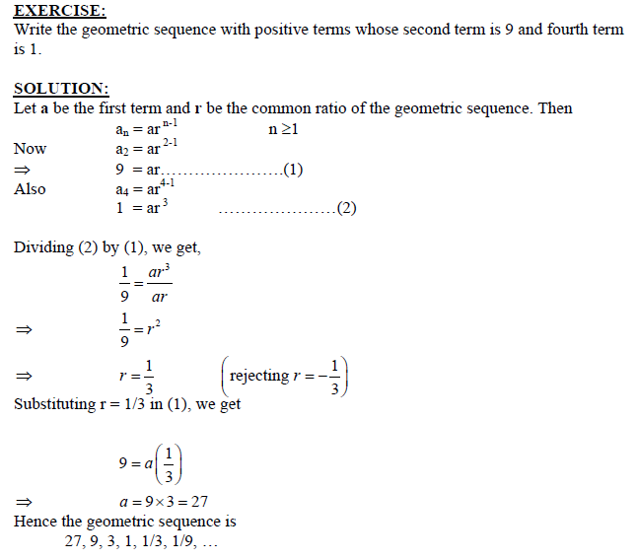
Geometric Sequence

Slide 76
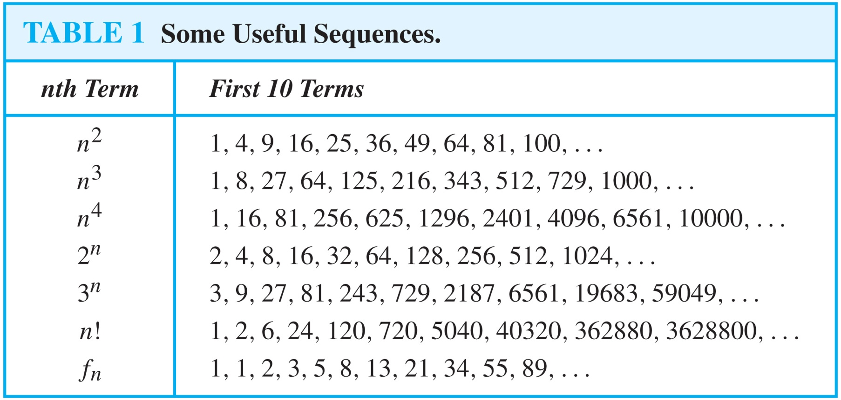
Useful Sequences

Slide 77
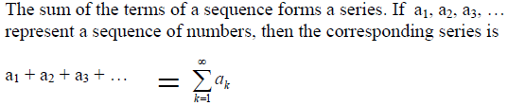
SERIES

Slide 78
SUMMATIONS

Slide 79
SUMMATIONS

Slide 80
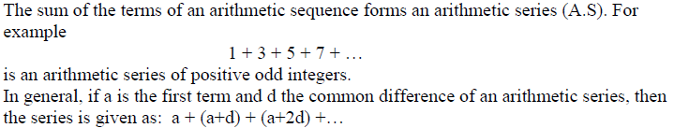
ARITHMETIC SERIES:

Slide 82
ARITHMETIC SERIES:

Slide 83
GEOMETRIC SERIES:

Slide 84
Strings
Definition: A string is a finite sequence of characters from a finite set (an alphabet).
Sequences of characters or bits are important in computer science.
The empty string is represented by λ.
The string abcde has length 5.

Slide 85
Recurrence Relations
Definition: A recurrence relation for the sequence {a_{n}} is an equation that expresses a_{n} in terms of one or more of the previous terms of the sequence, namely, a₀, a₁, …, a_{n-1}, for all integers n with n ≥ n₀, where n₀ is a nonnegative integer.
A sequence is called a solution of a recurrence relation if its terms satisfy the recurrence relation.
The initial conditions for a sequence specify the terms that precede the first term where the recurrence relation takes effect.

Slide 86
Questions about Recurrence Relations
Example 1: Let {a_{n}} be a sequence that satisfies the recurrence relation a_{n} = a_{n-1} + 3 for n = 1,2,3,4,…. and suppose that a₀ = 2. What are a₁ , a₂ and a₃?
[Here a₀ = 2 is the initial condition.]
Solution: We see from the recurrence relation that
a₁ = a₀ + 3 = 2 + 3 = 5
a₂ = 5 + 3 = 8
a₃ = 8 + 3 = 11

Slide 87
Questions about Recurrence Relations
Example 2: Let {a_{n}} be a sequence that satisfies the recurrence relation a_{n} = a_{n-1} – a_{n-2} for n = 2,3,4,…. and suppose that a₀ = 3 and a₁ = 5. What are a₂ and a₃?
[Here the initial conditions are a₀ = 3 and a₁ = 5. ]
Solution: We see from the recurrence relation that
a₂ = a₁ - a₀ = 5 – 3 = 2
a₃ = a₂ – a₁ = 2 – 5 = –3

Slide 88
Solving Recurrence Relations
Finding a formula for the nth term of the sequence generated by a recurrence relation is called solving the recurrence relation.
Such a formula is called a closed formula.
Various methods for solving recurrence relations will be covered in Chapter 8 where recurrence relations will be studied in greater depth.
Here we illustrate by example the method of iteration in which we need to guess the formula. The guess can be proved correct by the method of induction (Chapter 5).

Slide 89
Fibonacci Sequence
Definition: Define the Fibonacci sequence, f₀ ,f₁ ,f₂,…, by:
Initial Conditions: f₀ = 0, f₁ = 1
Recurrence Relation: f_{n} = f_{n-1} + f_{n-2}
Example: Find f₂ ,f₃ ,f₄ , f₅ and f₆ .
Answer:
f₂ = f₁ + f₀ = 1 + 0 = 1,
f₃ = f₂ + f₁ = 1 + 1 = 2,
f₄ = f₃ + f₂ = 2 + 1 = 3,
f₅ = f₄ + f₃ = 3 + 2 = 5,
f₆ = f₅ + f₄ = 5 + 3 = 8.

Slide 90
Iterative Solution Example
Method 1: Working upward, forward substitution
Let {a_{n}} be a sequence that satisfies the recurrence relation a_{n} = a_{n-1} + 3 for n = 2,3,4,…. and suppose that a₁ = 2.
a₂ = 2 + 3
a₃ = (2 + 3) + 3 = 2 + 3 ∙ 2
a₄ = (2 + 2 ∙ 3) + 3 = 2 + 3 ∙ 3
.
.
.
a_{n} = a_{n-1} + 3 = (2 + 3 ∙ (n – 2)) + 3 = 2 + 3(n – 1)

Slide 91
Iterative Solution Example
Method 2: Working downward, backward substitution
Let {a_{n}} be a sequence that satisfies the recurrence relation a_{n} = a_{n-1} + 3 for n = 2,3,4,…. and suppose that a₁ = 2.
a_{n} = a_{n-1} + 3
= (a_{n-2} + 3) + 3 = a_{n-2} + 3 ∙ 2
= (a_{n-3} + 3 )+ 3 ∙ 2 = a_{n-3} + 3 ∙ 3
.
.
.
= a₂ + 3(n – 2) = (a₁ + 3) + 3(n – 2) = 2 + 3(n – 1)

Slide 92
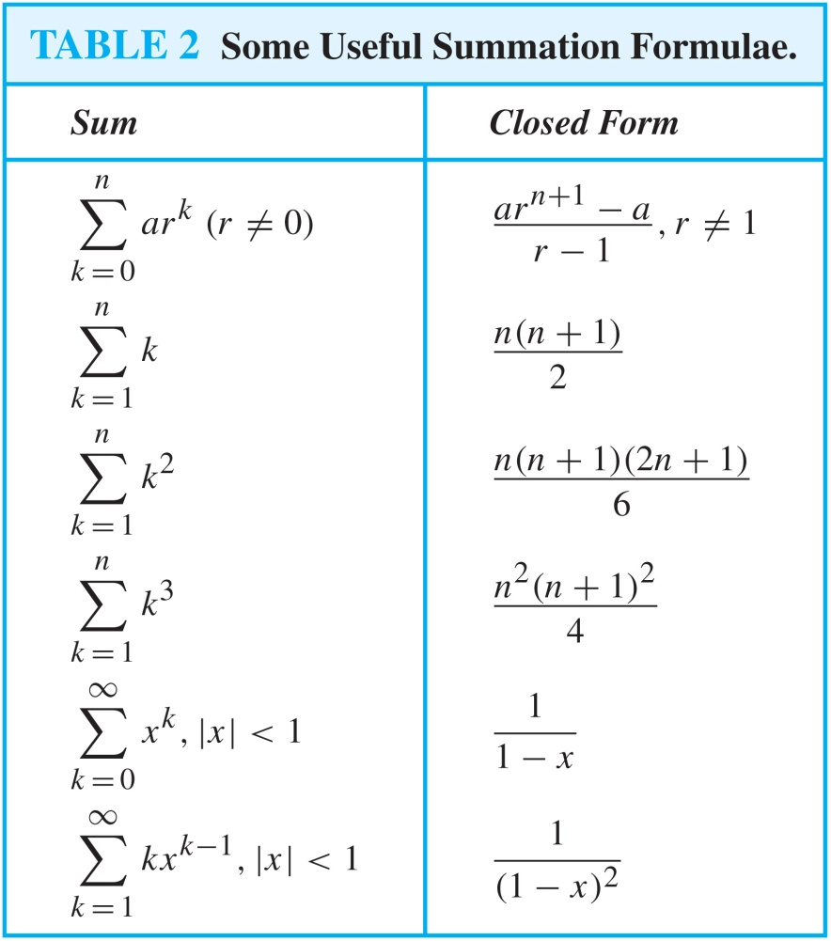
Some Useful Summation Formulae
Geometric Series: We just proved this.
Later we will prove some of these by induction.
Proof in text
(requires calculus)

Slide 93
Graphs
Chapter 10

Slide 94
Chapter Summary
Graphs and Graph Models
Graph Terminology and Special Types of Graphs
Representing Graphs and Graph Isomorphism
Connectivity
Euler and Hamiltonian Graphs
Shortest-Path Problems
Planar Graphs
Graph Coloring

Slide 95
Graphs and Graph Models
Section 10.1

Slide 96
Section Summary
Introduction to Graphs
Graph Taxonomy
Graph Models

Slide 97
Graphs
Definition: A graph G = (V, E) consists of a nonempty set V of vertices (or nodes) and a set E of edges. Each edge has either one or two vertices associated with it, called its endpoints. An edge is said to connect its endpoints.
Remarks:
The graphs we study here are unrelated to graphs of functions studied in Chapter 2.
We have a lot of freedom when we draw a picture of a graph. All that matters is the connections made by the edges, not the particular geometry depicted. For example, the lengths of edges, whether edges cross, how vertices are depicted, and so on, do not matter
A graph with an infinite vertex set is called an infinite graph. A graph with a finite vertex set is called a finite graph. We (following the text) restrict our attention to finite graphs.
Example:
a
b
This is a graph with four vertices and five edges.
d
c

Slide 98
Some Terminology
In a simple graph each edge connects two different vertices and no two edges connect the same pair of vertices.
Multigraphs may have multiple edges connecting the same two vertices. When m different edges connect the vertices u and v, we say that {u,v} is an edge of multiplicity m.
An edge that connects a vertex to itself is called a loop.
A pseudograph may include loops, as well as multiple edges connecting the same pair of vertices.
Example:
This pseudograph has both multiple edges and a loop.
a
b
Remark: There is no standard terminology for graph theory. So, it is crucial that you understand the terminology being used whenever you read material about graphs.
c

Slide 99
Directed Graphs
Definition: An directed graph (or digraph) G = (V, E) consists of a nonempty set V of vertices (or nodes) and a set E of directed edges (or arcs). Each edge is associated with an ordered pair of vertices. The directed edge associated with the ordered pair (u,v) is said to start at u and end at v.
Remark:
Graphs where the end points of an edge are not ordered are said to be undirected graphs.

Slide 100
Some Terminology (continued)
A simple directed graph has no loops and no multiple edges.
A directed multigraph may have multiple directed edges. When there are m directed edges from the vertex u to the vertex v, we say that (u,v) is an edge of multiplicity m.
Example:
a
b
This is a directed graph with three vertices and four edges.
c
Example:
In this directed multigraph the multiplicity of (a,b) is 1 and the multiplicity of (b,c) is 2.
a
b
c

Slide 101
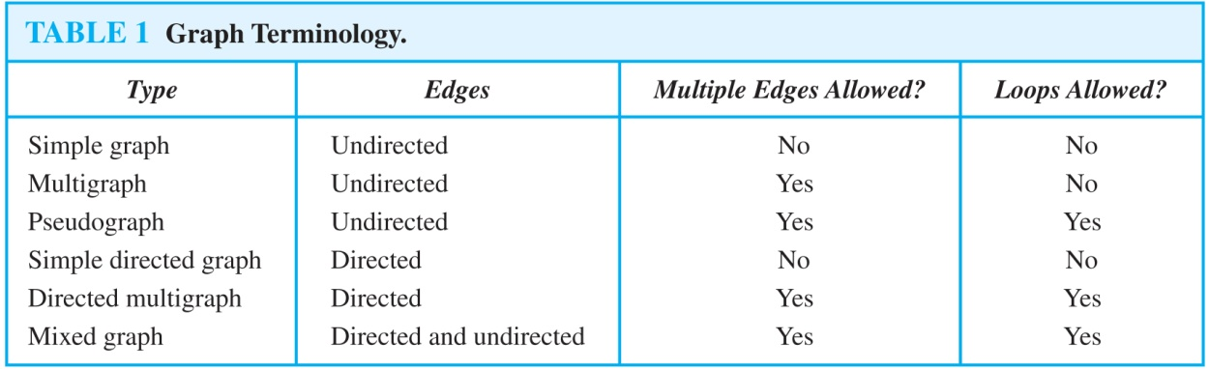
Graph Terminology: Summary
To understand the structure of a graph and to build a graph model, we ask these questions:
Are the edges of the graph undirected or directed (or both)?
If the edges are undirected, are multiple edges present that connect the same pair of vertices? If the edges are directed, are multiple directed edges present?
Are loops present?

Slide 102
Other Applications of Graphs
We will illustrate how graph theory can be used in models of:
Social networks
Communications networks
Information networks
Software design
Transportation networks
Biological networks
It’s a challenge to find a subject to which graph theory has not yet been applied. Can you find an area without applications of graph theory?

Slide 103
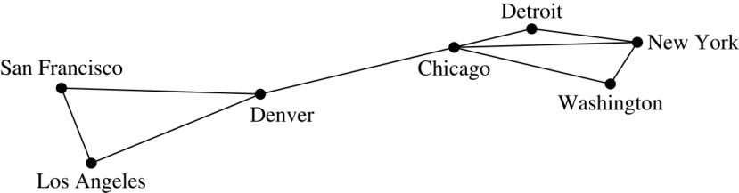
Graph Models: Computer Networks
When we build a graph model, we use the appropriate type of graph to capture the important features of the application.
We illustrate this process using graph models of different types of computer networks. In all these graph models, the vertices represent data centers and the edges represent communication links.
To model a computer network where we are only concerned whether two data centers are connected by a communications link, we use a simple graph. This is the appropriate type of graph when we only care whether two data centers are directly linked (and not how many links there may be) and all communications links work in both directions.

Slide 104
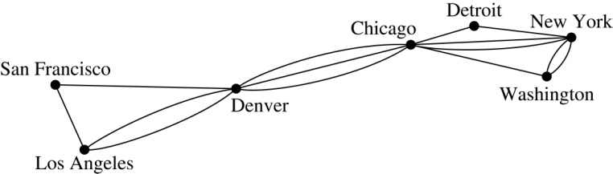
Graph Models: Computer Networks (continued)
To model a computer network where we care about the number of links between data centers, we use a multigraph.

Slide 105
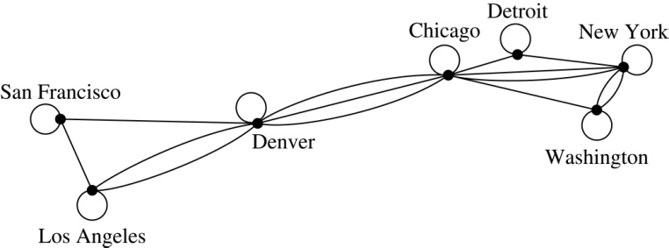
Graph Models: Computer Networks
To model a computer network with diagnostic links at data centers, we use a pseudograph, as loops are needed.

Slide 106
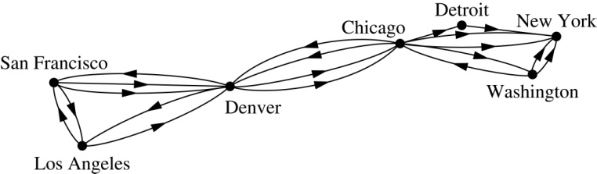
Graph Models: Computer Networks
To model a network with multiple one-way links, we use a directed multigraph. Note that we could use a directed graph without multiple edges if we only care whether there is at least one link from a data center to another data center.

Slide 107
Graph Models: Social Networks
Graphs can be used to model social structures based on different kinds of relationships between people or groups.
In a social network, vertices represent individuals or organizations and edges represent relationships between them.
Useful graph models of social networks include:
friendship graphs - undirected graphs where two people are connected if they are friends (in the real world, on Facebook, or in a particular virtual world, and so on.)
collaboration graphs - undirected graphs where two people are connected if they collaborate in a specific way
influence graphs - directed graphs where there is an edge from one person to another if the first person can influence the second person..

Slide 108

Graph Models: Social Networks
Example: A friendship graph where two people are connected if they are Facebook friends.

Slide 109

Graph Models: Social Networks
Example: An influence graph

Slide 110
Applications to Information Networks
Graphs can be used to model different types of networks that link different types of information.
In a web graph, web pages are represented by vertices and links are represented by directed edges.
A web graph models the web at a particular time.
We will explain how the web graph is used by search engines in Section 11.4.
In a citation network:
Research papers in a particular discipline are represented by vertices.
When a paper cites a second paper as a reference, there is an edge from the vertex representing this paper to the vertex representing the second paper.

Slide 111
Transportation Graphs
Graph models are extensively used in the study of transportation networks.
Airline networks can be modeled using directed multigraphs where
airports are represented by vertices
each flight is represented by a directed edge from the vertex representing the departure airport to the vertex representing the destination airport
Road networks can be modeled using graphs where
vertices represent intersections and edges represent roads.
undirected edges represent two-way roads and directed edges represent one-way roads.

Slide 112
Software Design Applications
Graph models are extensively used in software design. We will introduce two such models here; one representing the dependency between the modules of a software application and the other representing restrictions in the execution of statements in computer programs.
When a top-down approach is used to design software, the system is divided into modules, each performing a specific task.
We use a module dependency graph to represent the dependency between these modules. These dependencies need to be understood before coding can be done.

Slide 113

Software Design Applications
In a module dependency graph vertices represent software modules and there is an edge from one module to another if the second module depends on the first.
Example: The dependencies between the seven modules in the design of a web browser are represented by this module dependency graph.

Slide 114

Software Design Applications
We can use a directed graph called a precedence graph to represent which statements must have already been executed before we execute each statement.
Vertices represent statements in a computer program
There is a directed edge from a vertex to a second vertex if the second vertex cannot be executed before the first
Example: This precedence graph shows which statements must already have been executed before we can execute each of the six statements in the program.

Slide 115

Biological Applications
Graph models are used extensively in many areas of the biological science. We will describe two such models, one to ecology and the other to molecular biology.
Niche overlap graphs model competition between species in an ecosystem
Vertices represent species and an edge connects two vertices when they represent species who compete for food resources.
Example: This is the niche overlap graph for a forest ecosystem with nine species.

Slide 116
Biological Applications
We can model the interaction of proteins in a cell using a protein interaction network.
In a protein interaction graph, vertices represent proteins and vertices are connected by an edge if the proteins they represent interact.
Protein interaction graphs can be huge and can contain more than 100,000 vertices, each representing a different protein, and more than 1,000,000 edges, each representing an interaction between proteins
Protein interaction graphs are often split into smaller graphs, called modules, which represent the interactions between proteins involved in a particular function.

Slide 117

Biological Applications
Example: This is a module of the protein interaction graph of
proteins that degrade RNA in a human cell.

Slide 118
Graph Terminology and Special Types of Graphs
Section 10.2

Slide 119
Section Summary
Basic Terminology
Some Special Types of Graphs
Bipartite Graphs
Bipartite Graphs and Matchings
Some Applications of Special Types of Graphs
New Graphs from Old

Slide 120

Basic Terminology
Definition 1. Two vertices u, v in an undirected graph G are called adjacent (or neighbors) in G if there is an edge e between u and v. Such an edge e is called incident with the vertices u and v and e is said to connect u and v.
Definition 2. The set of all neighbors of a vertex v of G = (V, E), denoted by N(v), is called the neighborhood of v. If A is a subset of V, we denote by N(A) the set of all vertices in G that are adjacent to at least one vertex in A. So,
Definition 3. The degree of a vertex in a undirected graph is the number of edges incident with it, except that a loop at a vertex contributes two to the degree of that vertex. The degree of the vertex v is denoted by deg(v).

Slide 121

Degrees and Neighborhoods of Vertices
Example: What are the degrees and neighborhoods of the vertices in the graphs G and H?
Solution:
G: deg(a) = 2, deg(b) = deg(c) = deg(f ) = 4, deg(d ) = 1, deg(e) = 3, deg(g) = 0.
N(a) = {b, f }, N(b) = {a, c, e, f }, N(c) = {b, d, e, f }, N(d) = {c},
N(e) = {b, c , f }, N(f) = {a, b, c, e}, N(g) = ∅ .
H: deg(a) = 4, deg(b) = deg(e) = 6, deg(c) = 1, deg(d) = 5.
N(a) = {b, d, e}, N(b) = {a, b, c, d, e}, N(c) = {b}, N(d) = {a, b, e},
N(e) = {a, b ,d}.

Slide 122
Handshaking Theorem
Theorem: If G is any graph, then the sum of the degrees of all the vertices of G equals twice the number of edges of G.
Specifically, if the vertices of G are v1, v2, …, vn, where n is a positive integer, then
the total degree of G = deg(v1) + deg(v2) + … + deg(vn) = 2 . (the number of edges of G)
PROOF:
Each edge “e” of G connects its end points vi and vj. This edge, therefore contributes 1 to the degree of vi and 1 to the degree of vj.
If “e” is a loop, then it is counted twice in computing the degree of the vertex on which it is incident.
Accordingly, each edge of G contributes 2 to the total degree of G.
Thus, the total degree of G = 2. (the number of edges of G)
COROLLARY: The total degree of G is an even number

Slide 123

Degree of Vertices
Theorem: An undirected graph has an even number of vertices of odd degree.
Proof: Let V₁ be the vertices of even degree and V₂ be the vertices of odd degree in an undirected graph G = (V, E) with m edges. Then
even
must be even since deg(v) is even for each v ∈ V₁
This sum must be even because 2m is even and the sum of the degrees of the vertices of even degrees is also even. Because this is the sum of the degrees of all vertices of odd degree in the graph, there must be an even number of such vertices.

Slide 124
Handshaking Theorem
We now give two examples illustrating the usefulness of the handshaking theorem.
Example: How many edges are there in a graph with 10 vertices of degree six?
Solution: Because the sum of the degrees of the vertices is 6 ⋅ 10 = 60, the handshaking theorem tells us that 2m = 60. So the number of edges m = 30.
Example: If a graph has 5 vertices, can each vertex have degree 3?
Solution: This is not possible by the handshaking theorem, because the sum of the degrees of the vertices 3 ⋅ 5 = 15 is odd.

Slide 125
Directed Graphs
Recall the definition of a directed graph.
Definition: An directed graph G = (V, E) consists of V, a nonempty set of vertices (or nodes), and E, a set of directed edges or arcs. Each edge is an ordered pair of vertices. The directed edge (u,v) is said to start at u and end at v.
Definition: Let (u,v) be an edge in G. Then u is the initial vertex of this edge and is adjacent to v and v is the terminal (or end) vertex of this edge and is adjacent from u. The initial and terminal vertices of a loop are the same.

Slide 126

Directed Graphs (continued)
Definition: The in-degree of a vertex v, denoted deg⁻(v), is the number of edges which terminate at v. The out-degree of v, denoted deg⁺(v), is the number of edges with v as their initial vertex. Note that a loop at a vertex contributes 1 to both the in-degree and the out-degree of the vertex.
Example: In the graph G we have
deg⁻(a) = 2, deg⁻(b) = 2, deg⁻(c) = 3, deg⁻(d) = 2, deg⁻(e) = 3, deg⁻(f) = 0.
deg⁺(a) = 4, deg⁺(b) = 1, deg⁺(c) = 2, deg⁺(d) = 2, deg⁺ (e) = 3, deg⁺(f) = 0.

Slide 127

Directed Graphs (continued)
Theorem 3: Let G = (V, E) be a graph with directed edges. Then:
Proof: The first sum counts the number of outgoing edges over all vertices and the second sum counts the number of incoming edges over all vertices. It follows that both sums equal the number of edges in the graph.

Slide 128

Special Types of Simple Graphs: Complete Graphs
A complete graph on n vertices, denoted by K_{n}, is the simple graph that contains exactly one edge between each pair of distinct vertices.

Slide 129


Special Types of Simple Graphs: Cycles and Wheels
A cycle C_{n} for n ≥ 3 consists of n vertices v₁, v₂ ,⋯ , v_{n}, and edges {v₁, v₂}, {v₂, v₃} ,⋯ , {v_{n-1}, v_{n}}, {v_{n}, v₁}.
A wheel W_{n} is obtained by adding an additional vertex to a cycle C_{n} for n ≥ 3 and connecting this new vertex to each of the n vertices in C_{n} by new edges.

Slide 130

Special Types of Graphs and Computer Network Architecture
Various special graphs play an important role in the design of computer networks.
Some local area networks use a star topology, which is a complete bipartite graph K_{1,n} ,as shown in (a). All devices are connected to a central control device.
Other local networks are based on a ring topology, where each device is connected to exactly two others using C_{n} ,as illustrated in (b). Messages may be sent around the ring.
Others, as illustrated in (c), use a W_{n} – based topology, combining the features of a star topology and a ring topology.

Slide 131

Special Types of Simple Graphs: n-Cubes
An n-dimensional hypercube, or n-cube, Q_{n}, is a graph with 2^{n} vertices representing all bit strings of length n, where there is an edge between two vertices that differ in exactly one bit position.

Slide 132

Special Types of Graphs and Computer Network Architecture
Various special graphs also play a role in parallel processing where processors need to be interconnected as one processor may need the output generated by another.
The n-dimensional hypercube, or n-cube, Qn, is a common way to connect processors in parallel, e.g., Intel Hypercube.
Another common method is the mesh network, illustrated here for 16 processors.

Slide 133
Bipartite Graphs
Definition: A simple graph G is bipartite if V can be partitioned into two disjoint subsets V₁ and V₂ such that every edge connects a vertex in V₁ and a vertex in V₂. In other words, there are no edges which connect two vertices in V₁ or in V₂.
It is not hard to show that an equivalent definition of a bipartite graph is a graph where it is possible to color the vertices red or blue so that no two adjacent vertices are the same color.

Slide 134

Bipartite Graphs (continued)
Example: Show that C₃ is not bipartite.
Solution: If we divide the vertex set of C₃ into two nonempty sets, one of the two must contain two vertices. But in C₃ every vertex is connected to every other vertex. Therefore, the two vertices in the same partition are connected. Hence, C₃ is not bipartite.

Slide 135

Bipartite Graphs (continued)
Example: Show that C₆ is bipartite.
Solution: We can partition the vertex set into
V₁ = {v₁, v₃, v₅} and V₂ = {v₂, v₄, v₆} so that every edge of C₆ connects a vertex in V₁ and V₂ .

Slide 136

Bipartite Graphs
G is bipartite
H is not bipartite since if we color a red, then the adjacent vertices f and b must both be blue.

Slide 137

Bipartite Graphs and Matchings
Bipartite graphs are used to model applications that involve matching the elements of one set to elements in another, for example:
Job assignments - vertices represent the jobs and the employees, edges link employees with those jobs they have been trained to do. A common goal is to match jobs to employees so that the most jobs are done.

Slide 138

Bipartite Graphs and Matchings

Slide 139
Bipartite Graphs and Matchings

Slide 140

Complete Bipartite Graphs
Definition: A complete bipartite graph K_{m,n} is a graph that has its vertex set partitioned into two subsets V₁ of size m and V₂ of size n such that there is an edge from every vertex in V₁ to every vertex in V₂.
Example: We display four complete bipartite graphs here.

Slide 141

New Graphs from Old
Definition: A subgraph of a graph G = (V,E) is a graph (W,F), where W ⊂ V and F ⊂ E. A subgraph H of G is a proper subgraph of G if H ≠ G.
Example: Here we show K₅ and one of its subgraphs.
Definition: Let G = (V, E) be a simple graph. The subgraph induced by a subset W of the vertex set V is the graph (W,F), where the edge set F contains an edge in E if and only if both endpoints are in W.
Example: Here we show K₅ and the subgraph induced by W = {a,b,c,e}.

Slide 142

New Graphs from Old (continued)
Definition: The union of two simple graphs G₁ = (V₁, E₁) and G₂ = (V₂, E₂) is the simple graph with vertex set V₁ ⋃ V₂ and edge set E₁ ⋃ E₂. The union of G₁ and G₂ is denoted by G₁ ⋃ G₂.
Example:

Slide 143
Representations of Graphs
Section 10.3

Slide 144
Section Summary
Adjacency Lists
Adjacency Matrices
Incidence Matrices

Slide 145


Representing Graphs: Adjacency Lists
Definition: An adjacency list can be used to represent a graph with no multiple edges by specifying the vertices that are adjacent to each vertex of the graph.
Example:

Slide 146


Representing Graphs: Adjacency Lists
Example:

Slide 147

Representation of Graphs: Adjacency Matrices
Definition: Suppose that G = (V, E) is a simple graph where |V| = n. Arbitrarily list the vertices of G as v₁, v₂, … , v_{n}. The adjacency matrix A_{G} of G, with respect to the listing of vertices, is the n × n zero-one matrix with 1 as its (i, j)th entry when v_{i} and v_{j} are adjacent, and 0 as its (i, j)th entry when they are not adjacent.
In other words, if the graphs adjacency matrix is A_{G} = [a_{ij}], then

Slide 148




Adjacency Matrices (continued)
Example:
When a graph is sparse, that is, it has few edges relatively to the total number of possible edges, it is much more efficient to represent the graph using an adjacency list than an adjacency matrix. But for a dense graph, which includes a high percentage of possible edges, an adjacency matrix is preferable.
The ordering
of vertices is a, b, c, d.
The ordering of vertices is a, b, c, d.
Note: The adjacency matrix of a simple graph is symmetric, i.e., a_{ij} = a_{ji}
Also, since there are no loops, each diagonal entry a_{ij} for i = 1, 2, 3, …, n, is 0.

Slide 149

Adjacency Matrices (continued)
Adjacency matrices can also be used to represent graphs with loops and multiple edges.
A loop at the vertex vi is represented by a 1 at the (i, j)th position of the matrix.
When multiple edges connect the same pair of vertices vi and vj, (or if multiple loops are present at the same vertex), the (i, j)th entry equals the number of edges connecting the pair of vertices.
Example: We give the adjacency matrix of the pseudograph shown here using the ordering of vertices a, b, c, d.

Slide 150
Adjacency Matrices (continued)
Adjacency matrices can also be used to represent directed graphs. The matrix for a directed graph G = (V, E) has a 1 in its (i, j)th position if there is an edge from v_{i} to v_{j}, where v₁, v₂, … v_{n} is a list of the vertices.
In other words, if the graphs adjacency matrix is A_{G} = [a_{ij}], then
The adjacency matrix for a directed graph does not have to be symmetric, because there may not be an edge from v_{i} to v_{j}, when there is an edge from v_{j} to v_{i}.
To represent directed multigraphs, the value of a_{ij} is the number of edges connecting v_{i} to v_{j}.

Slide 151

Representation of Graphs: Incidence Matrices
Definition: Let G = (V, E) be an undirected graph with vertices where v₁, v₂, … v_{n} and edges e₁, e₂, … e_{m}. The incidence matrix with respect to the ordering of V and E is the n × m matrix M = [m_{ij}], where

Slide 152




Incidence Matrices (continued)
Example: Simple Graph and Incidence Matrix
The rows going from top to bottom represent v₁ through v₅ and the columns going from left to right represent e₁ through e₆.
Example: Pseudograph and Incidence Matrix
The rows going from top to bottom represent v₁ through v₅ and the columns going from left to right represent e₁ through e₈.

Slide 153
Connectivity
Section 10.4

Slide 154
Section Summary
Paths
Connectedness in Undirected Graphs
Connectedness in Directed Graphs
Counting Paths between Vertices

Slide 155
Paths
Informal Definition: A path is a sequence of edges that begins at a vertex of a graph and travels from vertex to vertex along edges of the graph. As the path travels along its edges, it visits the vertices along this path, that is, the endpoints of these.
Applications: Numerous problems can be modeled with paths formed by traveling along edges of graphs such as:
determining whether a message can be sent between two computers.
efficiently planning routes for mail delivery.

Slide 156
Paths
Definition: Let n be a nonnegative integer and G an undirected graph. A path of length n from u to v in G is a sequence of n edges e₁, … , e_{n} of G for which there exists a sequence x₀ = u, x₁, …, x_{n-1}, x_{n} = v of vertices such that e_{i} has, for i = 1, …, n, the endpoints x_{i-1} and x_{i}.
When the graph is simple, we denote this path by its vertex sequence x₀, x₁, … , x_{n}(since listing the vertices uniquely determines the path).
The path is a circuit if it begins and ends at the same vertex (u = v) and has length greater than zero.
The path or circuit is said to pass through the vertices x₁, x₂, … , x_{n-1} and traverse the edges e₁, … , e_{n}.
A path or circuit is simple if it does not contain the same edge more than once.

Slide 157

Paths (continued)
Example: In the simple graph here:
a, d, c, f, e is a simple path of length 4.
d, e, c, a is not a path because e is not connected to c.
b, c, f, e, b is a circuit of length 4.
a, b, e, d, a, b is a path of length 5, but it is not a simple path.

Slide 158

Connectedness in Undirected Graphs
Definition: An undirected graph is called connected if there is a path between every pair of vertices. An undirected graph that is not connected is called disconnected. We say that we disconnect a graph when we remove vertices or edges, or both, to produce a disconnected subgraph.
Example: G₁ is connected because there is a path between any pair of its vertices, as can be easily seen. However G₂ is not connected because there is no path between vertices a and f, for example.

Slide 159
Euler and Hamiltonian Graphs
Section 10.5

Slide 160
Section Summary
Euler Paths and Circuits
Hamilton Paths and Circuits
Applications of Hamilton Circuits

Slide 161



Euler Paths and Circuits
The town of Kӧnigsberg, Prussia
(now Kalingrad, Russia) was divided into
four sections by the branches of the Pregel river. In the 18th century seven bridges connected these regions.
People wondered whether whether it was possible to follow a path that crosses each bridge exactly once and returns to the starting point.
The Swiss mathematician Leonard Euler proved that no such path exists. This result is often considered to be the first theorem ever proved in graph theory.
Leonard Euler (1707-1783)
Multigraph Model of the Bridges of Kӧnigsberg
The 7 Bridges of Kӧnigsberg

Slide 162

Euler Paths and Circuits
Definition: An Euler circuit in a graph G is a simple circuit containing every edge of G. An Euler path in G is a simple path containing every edge of G.
Example: Which of the undirected graphs G₁, G₂, and G₃ has a Euler circuit? Of those that do not, which has an Euler path?
Solution: The graph G₁ has an Euler circuit (e.g., a, e, c, d, e, b, a). But, as can easily be verified by inspection, neither G₂ nor G₃ has an Euler circuit. Note that G₃ has an Euler path (e.g., a, c, d, e, b, d, a, b), but there is no Euler path in G₂, which can be verified by inspection.

Slide 163
Necessary Conditions for Euler Circuits and Paths
An Euler circuit begins with a vertex a and continues with an edge incident with a, say {a, b}. The edge {a, b} contributes one to deg(a).
Each time the circuit passes through a vertex it contributes two to the vertex’s degree.
Finally, the circuit terminates where it started, contributing one to deg(a). Therefore deg(a) must be even.
We conclude that the degree of every other vertex must also be even.
By the same reasoning, we see that the initial vertex and the final vertex of an Euler path have odd degree, while every other vertex has even degree. So, a graph with an Euler path has exactly two vertices of odd degree.
In the next slide we will show that these necessary conditions are also sufficient conditions.

Slide 164

Sufficient Conditions for Euler Circuits and Paths
Suppose that G is a connected multigraph with ≥ 2 vertices, all of even degree. Let x₀ = a be a vertex of even degree. Choose an edge {x₀, x₁} incident with a and proceed to build a simple path {x₀, x₁}, {x₁, x₂}, …, {x_{n-1}, x_{n}} by adding edges one by one until another edge can not be added.
The path begins at a with an edge of the
form {a, x}; we show that it must terminate
at a with an edge of the form {y, a}. Since each vertex has an even degree, there must be an even number of edges incident with this vertex. Hence, every time we enter a vertex other than a, we can leave it. Therefore, the path can only end at a.
If all of the edges have been used, an Euler circuit has been constructed. Otherwise, consider the subgraph H obtained from G by deleting the edges already used.
We illustrate this idea in the graph G here. We begin at a and choose the edges {a, f}, {f, c}, {c, b}, and {b, a} in succession.
In the example H consists of the vertices c, d, e.

Slide 165
Sufficient Conditions for Euler Circuits and Paths
Because G is connected, H must have at least one vertex in common with the circuit that has been deleted.
Every vertex in H must have even degree because all the vertices in G have even degree and for each vertex, pairs of edges incident with this vertex have been deleted. Beginning with the shared vertex construct a path ending in the same vertex (as was done before). Then splice this new circuit into the original circuit.
Continue this process until all edges have been used. This produces an Euler circuit. Since every edge is included and no edge is included more than once.
Similar reasoning can be used to show that a graph with exactly two vertices of odd degree must have an Euler path connecting these two vertices of odd degree
In the example, the vertex is c.
In the example, we end up with the circuit a, f, c, d, e, c, b, a.

Slide 166
Algorithm for Constructing an Euler Circuits
In our proof we developed this algorithms for constructing a Euler circuit in a graph with no vertices of odd degree.
procedure Euler(G: connected multigraph with all vertices of even degree)
circuit := a circuit in G beginning at an arbitrarily chosen vertex with edges
successively added to form a path that returns to this vertex.
H := G with the edges of this circuit removed
while H has edges
subciruit := a circuit in H beginning at a vertex in H that also is
an endpoint of an edge in circuit.
H := H with edges of subciruit and all isolated vertices removed
circuit := circuit with subcircuit inserted at the appropriate vertex.
return circuit{circuit is an Euler circuit}

Slide 167
Necessary and Sufficient Conditions for Euler Circuits and Paths (continued)
Theorem: A connected multigraph with at least two vertices has an Euler circuit if and only if each of its vertices has an even degree and it has an Euler path if and only if it has exactly two vertices of odd degree.
Example: Two of the vertices in the multigraph model of the Kӧnigsberg bridge problem have odd degree. Hence, there is no Euler circuit in this multigraph and it is impossible to start at a given point, cross each bridge exactly once, and return to the starting point.

Slide 168

Euler Circuits and Paths
Example:
G₁ contains exactly two vertices of odd degree (b and d). Hence it has an Euler path, e.g., d, a, b, c, d, b.
G₂ has exactly two vertices of odd degree (b and d). Hence it has an Euler path, e.g., b, a, g, f, e, d, c, g, b, c, f, d.
G₃ has six vertices of odd degree. Hence, it does not have an Euler path.

Slide 169
Applications of Euler Paths and Circuits
Euler paths and circuits can be used to solve many practical problems such as finding a path or circuit that traverses each
street in a neighborhood,
road in a transportation network,
connection in a utility grid,
link in a communications network.
Other applications are found in the
layout of circuits,
network multicasting,
molecular biology, where Euler paths are used in the sequencing of DNA.

Slide 170



Hamilton Paths and Circuits
William Rowan Hamilton (1805- 1865)
Euler paths and circuits contained every edge only once.
Now we look at paths and circuits that contain every vertex exactly once.
William Hamilton invented the Icosian puzzle in 1857. It consisted of a wooden dodecahedron (with 12 regular pentagons as faces), illustrated in (a), with a peg at each vertex, labeled with the names of different cities. String was used to used to plot a circuit visiting 20 cities exactly once
The graph form of the puzzle is given in (b).
The solution (a Hamilton circuit) is given here.

Slide 171
Hamilton Paths and Circuits
Definition: A simple path in a graph G that passes through every vertex exactly once is called a Hamilton path, and a simple circuit in a graph G that passes through every vertex exactly once is called a Hamilton circuit.
That is, a simple path x₀, x₁, …, x_{n-1}, x_{n} in the graph G = (V, E) is called a Hamilton path if V = {x₀, x₁, … , x_{n-1,} x_{n} } and x_{i} ≠ x_{j} for 0≤ i < j ≤ n, and the simple circuit x₀, x₁, …, x_{n-1}, x_{n}, x₀ (with n > 0) is a Hamilton circuit if x₀, x₁, … , x_{n-1}, x_{n} is a Hamilton path.

Slide 172
Hamilton Paths and Circuits
Example: Which of these simple graphs has a Hamilton circuit or, if not, a Hamilton path?
Solution:
G₁ does not have a Hamilton circuit (Why?), but does have a Hamilton path : a, b ,e , c, d.
G₂ has a Hamilton circuit: a, b, c, d, e, a.
G₃ has a Hamilton circuit: a,b,e,d,c,a

Slide 173


Necessary Conditions for Hamilton Circuits
Gabriel Andrew Dirac
(1925-1984)
Unlike for an Euler circuit, no simple necessary and sufficient conditions are known for the existence of a Hamiton circuit.
However, there are some useful necessary conditions. We describe two of these now.
Dirac’s Theorem: If G is a simple graph with n ≥ 3 vertices such that the degree of every vertex in G is ≥ n/2, then G has a Hamilton circuit.
Ore’s Theorem: If G is a simple graph with n ≥ 3 vertices such that deg(u) + deg(v) ≥ n for every pair of nonadjacent vertices, then G has a Hamilton circuit.
Øysten Ore
(1899-1968)

Slide 174
Applications of Hamilton Paths and Circuits
Applications that ask for a path or a circuit that visits each intersection of a city, each place pipelines intersect in a utility grid, or each node in a communications network exactly once, can be solved by finding a Hamilton path in the appropriate graph.
The famous traveling salesperson problem (TSP) asks for the shortest route a traveling salesperson should take to visit a set of cities. This problem reduces to finding a Hamilton circuit such that the total sum of the weights of its edges is as small as possible.
A family of binary codes, known as Gray codes, which minimize the effect of transmission errors, correspond to Hamilton circuits in the n-cube Q_{n.}

Slide 175
ISOMORPHISM OF GRAPHS
Section 10.3

Slide 176
Isomorphism of Graphs
Definition: The simple graphs G₁ = (V₁, E₁) and G₂ = (V₂, E₂) are isomorphic if there is a one-to-one and onto function f from V₁ to V₂ with the property that a and b are adjacent in G₁ if and only if f(a) and f(b) are adjacent in G₂ , for all a and b in V₁ . Such a function f is called an isomorphism. Two simple graphs that are not isomorphic are called nonisomorphic.

Slide 177
Isomorphism of Graphs
It is difficult to determine whether two simple graphs are isomorphic using brute force because there are n! possible one-to-one correspondences between the vertex sets of two simple graphs with n vertices.
The best algorithms for determining weather two graphs are isomorphic have exponential worst case complexity in terms of the number of vertices of the graphs.
Sometimes it is not hard to show that two graphs are not isomorphic. We can do so by finding a property, preserved by isomorphism, that only one of the two graphs has. Such a property is called graph invariant.
There are many different useful graph invariants that can be used to distinguish nonisomorphic graphs, such as the number of vertices, number of edges, and degree sequence (list of the degrees of the vertices in nonincreasing order). We will encounter others in later sections of this chapter.

Slide 178
ISOMORPHIC INVARIANT
A property P is called an isomorphic invariant if, and only if, given any graphs G and G’,
If G has property P and G’ is isomorphic to G, then G’ has property P.
THEOREM OF ISOMORPHIC INVARIANT
Each of the following properties is an invariant for graph isomorphism, where n, m and k are all non-negative integers, if the graph:
1. has n vertices.
2. has m edges.
3. has a vertex of degree k.
4. has m vertices of degree k.
5. has a circuit of length k.
6. has a simple circuit of length k.
7. has m simple circuits of length k.
8. is connected.
9. has an Euler circuit.
10. has a Hamiltonian circuit.

Slide 179

Isomorphism of Graphs (cont.)
Example: Show that the graphs G =(V, E) and H = (W, F) are isomorphic.
Solution: The function f with
f(u₁) = v₁,f(u₂) = v₄, f(u₃) = v₃, and f(u₄) = v₂ is a one-to-one
correspondence between V and W.
Note that adjacent vertices in G are
u₁ and u₂, u₁ and u₃, u₂ and u₄,
and u₃ and u₄. Each of the pairs
f(u₁) = v₁ and f(u₂) = v₄, f(u₁) = v₁
and f(u₃) = v₃ , f(u₂) = v₄ and
f(u₄) = v₂ , and f(u₃) = v₃ and
f(u₄) = v₂ consists of two adjacent vertices in H.

Slide 180



Isomorphism of Graphs
Example: Show that the graphs G =(V, E) and G’ = (W, F) are isomorphic.
Solution: The function f with
f(v1) = v1,f(v2) = v3, f(v3) = v5, f(v4) = v2 and f(v5) = v4 is a one-to-one correspondence between V and W.
Note that adjacent vertices in G are v1 and v2, v2 and v3, v3 and v4, v4 and v5 and v5 and v1.
Each of the pairs f(v1) = v1 and f(v2) = v3, f(v2) = v3 and f(v3) = v5 , f(v3) = v5 and
f(v4) = v2 , f(v4) = v2 and f(v5) = v4 and f(v5) = v4 and f(v1) = v1 consists of two adjacent vertices in H.

Slide 181

Isomorphism of Graphs
EXAMPLE: Determine whether the graph G and G’ given below are isomorphic.
SOLUTION:
As both the graphs have the same number of vertices. But the graph G has 7 edges and the graph G’ has only 6 edges. Therefore the two graphs are not isomorphic.
Note: As the edges of both the graphs G and G’ are not same then how the one-one correspondence is possible ,that the reason the graphs G and G’ are not isomorphic.

Slide 182

Isomorphism of Graphs
EXAMPLE: Determine whether the graph G and G’ given below are isomorphic.
SOLUTION:
Both the graphs have 5 vertices and 7 edges. The vertex q of G’ has degree 5. However G does not have any vertex of degree 5 (so one-one correspondence is not possible). Hence, the two graphs are not isomorphic.

Slide 183

Isomorphism of Graphs
EXAMPLE: Determine whether the graph G and G’ given below are isomorphic.
SOLUTION:
Clearly the vertices of both the graphs G and G’ have the same degree (i.e “2”) and having the same number of vertices and edges but isomorphism is not possible. As the graph G’ is a connected graph but the graph G is not connected due to have two components (eca and bdf). Therefore the two graphs are non isomorphic.

Slide 184

Isomorphism of Graphs
EXAMPLE: Determine whether the graph G and G’ given below are isomorphic.
SOLUTION:
Clearly G has six vertices, G’ also has six vertices. And the graph G has two simple circuits of length 3; one is abca and the other is defd. But G’ does not have any simple circuit of length 3(as one simple circuit in G’ is uxwv of length 4).Therefore the two graphs are non-isomorphic.
Note: A simple circuit is a circuit that does not have any other repeated vertex except the first and last.

Slide 185

Isomorphism of Graphs
EXAMPLE: Determine whether the graph G and G’ given below are isomorphic.
SOLUTION:
Both the graph G and G’ have 8 vertices and 12 edges and both are also called regular graph(as each vertex has degree 3).The graph G has two simple circuits of length 5; abcfea(i.e starts and ends at a) and cdhgfc(i.e starts and ends at c). But G’ does not have any simple circuit of length 5 (it has simple circuit tyxut,vwxuv of length 4 etc). Therefore the two graphs are non-isomorphic.

Slide 186



Isomorphism of Graphs
EXAMPLE: Determine whether the given graph G and H are isomorphic.
Solution:
Solution: The function f with
f(a) = u, f(b) = v, f(c) = y, f(d) = x, f(e) = w and f(f) = z is a one-to-one correspondence between G and H.
Note that adjacent vertices in G are a and b, b and c, c and d, c and f, d and e, e and f and f and a.
Each of the pairs f(a) = u and f(b) = v, f(b) = v and f(c) = y , f(c) = y and f(d) = x , f(c) = y and f(f) = z , f(d) = x and f(e) = w, f(e) = w and f(f) = z and f(f) = z and f(a) = u consists of two adjacent vertices in H.

Slide 187


Isomorphism of Graphs (cont.)
Example: Determine whether these two graphs are isomorphic.
Solution: Both graphs have eight vertices and ten edges.
They also both have four vertices of degree two and four of degree three.
However, G and H are not isomorphic. Note that since deg(a) = 2 in G, a must correspond to t, u, x, or y in H, because these are the vertices of degree 2. But each of these vertices is adjacent to another vertex of degree two in H, which is not true for a in G.
Alternatively, note that the subgraphs of G and H
made up of vertices of degree three and the edges
connecting them must be isomorphic.
But the subgraphs, as shown at the right,
are not isomorphic.

Slide 188

Isomorphism of Graphs
Example: Determine whether these two graphs are isomorphic.
Solution: Both graphs have six vertices and seven edges.
They also both have four vertices of degree two and two of degree three.
The subgraphs of G and H consisting of all the vertices of degree two and the edges connecting them are isomorphic. So, it is reasonable to try to find an isomorphism f.
We define an injection f from the vertices of G to the vertices of H that preserves the degree of vertices. We will determine whether it is an isomorphism.
The function f with f(u₁) = v₆, f(u₂) = v₃, f(u₃) = v₄, and f(u₄) = v₅ , f(u₅) = v₁, and f(u₆) = v₂ is a one-to-one correspondence between G and H. Showing that this correspondence preserves edges is straightforward, so we will omit the details here. Because f is an isomorphism, it follows that G and H are isomorphic graphs.

Slide 189
Algorithms for Graph Isomorphism
The best algorithms known for determining whether two graphs are isomorphic have exponential worst-case time complexity (in the number of vertices of the graphs).
However, there are algorithms with linear average-case time complexity.
You can use a public domain program called NAUTY to determine in less than a second whether two graphs with as many as 100 vertices are isomoprhic.
Graph isomorphism is a problem of special interest because it is one of a few NP problems not known to be either tractable or NP-complete (see Section 3.3).

Slide 190
Applications of Graph Isomorphism
The question whether graphs are isomorphic plays an important role in applications of graph theory. For example,
chemists use molecular graphs to model chemical compounds. Vertices represent atoms and edges represent chemical bonds. When a new compound is synthesized, a database of molecular graphs is checked to determine whether the graph representing the new compound is isomorphic to the graph of a compound that this already known.
Electronic circuits are modeled as graphs in which the vertices represent components and the edges represent connections between them. Graph isomorphism is the basis for
the verification that a particular layout of a circuit corresponds to the design’s original schematics.
determining whether a chip from one vendor includes the intellectual property of another vendor.

Slide 191
Shortest Paths

Slide 192
Weighted Graphs
Graphs that have a number assigned to each edge are called weighted graphs.
BOS
CHI
NY
SF
DEN
ATL
LA
MIA

Slide 193
Weighted Graphs
MILES
BOS
2534
860
191
1855
722
NY
CHI
SF
DEN
908
957
606
760
349
834
2451
1090
ATL
LA
595
MIA

Slide 194
Weighted Graphs
FARES
BOS
$129
$79
$39
$99
$59
NY
CHI
SF
DEN
$69
$89
$79
$89
$99
$39
$129
ATL
LA
$69
MIA

Slide 195
Weighted Graphs
FLIGHT TIMES
BOS
4:05
2:10
0:50
2:55
NY
CHI
1:50
SF
DEN
2:10
2:20
1:55
1:40
1:15
2:00
3:50
2:45
ATL
LA
1:30
MIA

Slide 196
Weighted Graphs
A weighted graph is a graph in which each edge (u, v) has a weight w(u, v). Each weight is a real number.
Weights can represent distance, cost, time, capacity, etc.
The length of a path in a weighted graph is the sum of the weights on the edges.
Dijkstra’s Algorithm finds the shortest path between two vertices.

Slide 197
Dijkstra’s Algorithm
Dijkstra’s algorithm is used in problems relating to finding the shortest path.
Each node is given a temporary label denoting the length of the shortest path from the start node so far.
This label is replaced if another shorter route is found.
Once it is certain that no other shorter paths can be found, the temporary label becomes a permanent label.
Eventually all the nodes have permanent labels.
At this point the shortest path is found by retracing the path backwards.

Slide 198
Dijkstra’s algorithm: example
D(v)
D(w)
D(x)
D(y)
D(z)
Step
N'
0
u
7,u
3,u
5,u
∞
∞
1
uw
6,w
5,u
11,w
∞
2
uwx
6,w
11,w
14,x
3
uwxv
10,v
14,x
4
uwxvy
12,y
5
uwxvyz
x
9
notes:
construct shortest path tree by tracing predecessor nodes
ties can exist (can be broken arbitrarily)
5
7
4
8
u
3
w
y
z
2
3
7
4
v

Slide 199
Dijkstra’s algorithm: another example
Step
0
1
2
3
4
5
N'
u
ux
uxy
uxyv
uxyvw
uxyvwz
D(v)
2,u
2,u
2,u
D(w)
5,u
4,x
3,y
3,y
D(x)
1,u
D(y)
∞
2,x
D(z)
∞
∞
4,y
4,y
4,y
5
v
3
w
2
5
u
2
1
z
3
1
2
x
y
1

Slide 200


Slide 201
Problem: shortest path from a to z
b
d
5
f
5
4
7
3
4
1
2
a
z
3
4
c
5
e
5
g

Slide 202
The Traveling Salesman Problem
The traveling salesman problem is one of the classical problems in computer science.
A traveling salesman wants to visit a number of cities and then return to his starting point. Of course he wants to save time and energy, so he wants to determine the shortest cycle for his trip.
We can represent the cities and the distances between them by a weighted, complete, undirected graph.
The problem then is to find the shortest cycle (of minimum total weight that visits each vertex exactly one).
Finding the shortest cycle is different than Dijkstra’s shortest path. It is much harder too, no polynomial time algorithm exists!

Slide 203
The Traveling Salesman Problem
Importance:
Variety of scheduling application can be solved as a traveling salesmen problem.
Examples:
Ordering drill position on a drill press.
School bus routing.
The problem has theoretical importance because it represents a class of difficult problems known as NP-hard problems.

Slide 204

Travelling Salesman problem

Slide 205

Travelling Salesman problem

Slide 206
Planar Graphs

Slide 207

The House-and-Utilities Problem

Slide 208
Planar Graphs
Consider the previous slide. Is it possible to join the three houses to the three utilities in such a way that none of the connections cross?

Slide 209
Planar Graphs
Phrased another way, this question is equivalent to: Given the complete bipartite graph K_{3,3}, can K_{3,3} be drawn in the plane so that no two of its edges cross?
K_{3,3}

Slide 210
Planar Graphs
A graph is called planar if it can be drawn in the plane without any edges crossing.
A crossing of edges is the intersection of the lines or arcs representing them at a point other than their common endpoint.
Such a drawing is called a planar representation of the graph.

Slide 211
Example
A graph may be planar even if it is usually drawn with crossings, since it may be possible to draw it in another way without crossings.

Slide 212


Example
A graph may be planar even if it represents a 3-dimensional object.

Slide 213
Planar Graphs
We can prove that a particular graph is planar by showing how it can be drawn without any crossings.
However, not all graphs are planar.
It may be difficult to show that a graph is nonplanar. We would have to show that there is no way to draw the graph without any edges crossing.

Slide 214
Regions
Euler showed that all planar representations of a graph split the plane into the same number of regions, including an unbounded region.
R₄ R₃ R₂
R₁

Slide 215
Regions
In any planar representation of K_{3,3}, vertex v₁ must be connected to both v₄ and v₅, and v₂ also must be connected to both v₄ and v₅.
v₁ v₂ v₃
v₄ v₅ v₆

Slide 216
Regions
The four edges {v₁, v₄}, {v₄, v₂}, {v₂, v₅}, {v₅, v₁} form a closed curve that splits the plane into two regions, R₁ and R₂.
v₁ v₅
R₂ R₁
v₄ v₂

Slide 217
Regions
Next, we note that v₃ must be in either R₁ or R₂.
Assume v₃ is in R₂. Then the edges {v₃, v₄} and {v₄, v₅} separate R₂ into two subregions, R₂₁ and R₂₂.
v₁ v₅ v₁ v₅
R₂₁
R₂ R₁ → v₃
R₂₂
v₄ v₂ v₄ v₂

Slide 218
Regions
Now there is no way to place vertex v₆ without forcing a crossing:
If v₆ is in R₁ then {v₆, v₃} must cross an edge
If v₆ is in R₂₁ then {v₆, v₂} must cross an edge
If v₆ is in R₂₂ then {v₆, v₁} must cross an edge
v₁ v₅
R₂₁
v₃ R₁
R₂₂
v₄ v₂

Slide 219
Regions
Alternatively, assume v₃ is in R₁. Then the edges {v₃, v₄} and {v₄, v₅} separate R₁ into two subregions, R₁₁ and R₁₂.
v₁ v₅
R₁₁
R₂ R₁₂ v₃
v₄ v₂

Slide 220
Regions
Now there is no way to place vertex v₆ without forcing a crossing:
If v₆ is in R₂ then {v₆, v₃} must cross an edge
If v₆ is in R₁₁ then {v₆, v₂} must cross an edge
If v₆ is in R₁₂ then {v₆, v₁} must cross an edge
v₁ v₅
R₁₁
R₂ R₁₂ v₃
v₄ v₂

Slide 221
Planar Graphs
Consequently, the graph K_{3,3} must be nonplanar.
K_{3,3}

Slide 222
Regions
Euler devised a formula for expressing the relationship between the number of vertices, edges, and regions of a planar graph.
These may help us determine if a graph can be planar or not.

Slide 223
Euler’s Formula
Let G be a connected planar simple graph with e edges and v vertices. Let r be the number of regions in a planar representation of G. Then r = e - v + 2.
R₄ R₃ R₂
R₁
# of edges, e = 6
# of vertices, v = 4
# of regions, r = e - v + 2 = 4

Slide 224
Euler’s Formula (Cont.)
Corollary 1: If G is a connected planar simple graph with e edges and v vertices where v ≥ 3, then e ≤ 3v - 6.
Is K₅ planar?
K₅

Slide 225
Euler’s Formula (Cont.)
K₅ has 5 vertices and 10 edges.
We see that v ≥ 3.
So, if K₅ is planar, it must be true that e ≤ 3v – 6.
3v – 6 = 3*5 – 6 = 15 – 6 = 9.
So e must be ≤ 9.
But e = 10.
So, K₅ is nonplanar.
K₅

Slide 226
Euler’s Formula (Cont.)
Corollary 2: If G is a connected planar simple graph, then G must have a vertex of degree not exceeding 5.
If G has one or two vertices, it is true;
thus, we assume that G has at least three vertices.
If the degree of each vertex were at least 6, then by Handshaking Theorem,
2e ≥ 6v, i.e., e ≥ 3v,
but this contradicts the inequality from
Corollary 1: 1 e ≤ 3v – 6.

Slide 227
Euler’s Formula (Cont.)
Corollary 3: If a connected planar simple graph has e edges and v vertices with v ≥ 3 and no circuits of length 3, then e ≤ 2v - 4.
Is K_{3,3} planar?

Slide 228
Euler’s Formula (Cont.)
K_{3,3} has 6 vertices and 9 edges.
Obviously, v ≥ 3 and there are no circuits of length 3.
If K_{3,3} were planar, then e ≤ 2v – 4 would have to be true.
2v – 4 = 2*6 – 4 = 8
So e must be ≤ 8.
But e = 9.
So K_{3,3} is nonplanar.
K_{3,3}

Slide 229
Trees
Chapter 11

Slide 230
Chapter Summary
Introduction to Trees
Applications of Trees
Tree Traversal
Spanning Trees
Minimum Spanning

Slide 231
Introduction to Trees
Section 11.1

Slide 232
Section Summary
Introduction to Trees
Rooted Trees
Trees as Models
Properties of Trees

Slide 233
Trees
Definition: A tree is a connected undirected graph with no simple circuits.
Definition: An undirected graph is a tree if and only if there is a unique simple path between any two of its vertices. A tree cannot contain multiple edges or loops.
Definition: An undirected graph is a tree if and only if there is a unique simple path between any two of its vertices.

Slide 234

Trees
Example: Which of these graphs are trees?
Solution: G₁ and G₂ are trees - both are connected and have no simple circuits. G₃ is not a tree because e, b, a, d, e is a simple circuit,. G₄ is not a tree because it is not connected.

Slide 235

FOREST
Definition: A forest is a graph that has no simple circuit, but is not connected. Each of the connected components in a forest is a tree.

Slide 236
Applications of Trees
Section 11.2

Slide 237


Trees as Models
Arthur Cayley
(1821-1895)
Trees are used as models in computer science, chemistry, geology, botany, psychology, and many other areas.
Trees were introduced by the mathematician Cayley in 1857 in his work counting the number of isomers of saturated hydrocarbons. The two isomers of butane are:.

Slide 238

Trees as Models
The organization of a computer file system into directories, subdirectories, and files is naturally represented as a tree.

Slide 239

Trees as Models
Trees are used to represent the structure of organizations.

Slide 240
Applications of Trees
Game Trees
Trees can be used to analyze certain types of games such as tic-tac-toe, nim, checkers, and chess.

Slide 241

Game Tree for Tic-Tac-Toe

Slide 242

Universal Address Systems

Slide 243

Prefix code
Definition: A code that has the property that the code of a character is never a prefix of the code of another character.
A prefix code can be represented using a binary tree, where the characters are the labels of the leaves in the tree.
The edges of the tree are labeled so that an edge leading to a left child is assigned a 0 and an edge leading to a right child is assigned a 1.
The bit string used to encode a character is the sequence of labels of the edges in the unique path from the root to the leaf that has this character as its label.
For instance, the tree in Figure 5 represents the encoding of e by 0, a by 10, t by 110, n by 1110, and s by 1111.

Slide 244
Decision Trees
Definition: A rooted tree where each vertex represents a possible outcome of a decision and the leaves represent the possible solutions of a problem.
Rooted trees can be used to model problems in which a series of decisions leads to a solution.
The possible solutions of the problem correspond to the paths to the leaves of this rooted tree.

Slide 245

Example : A decision tree that orders the elements of the list a, b, c.

Slide 246

Rooted Trees
Definition: A rooted tree is a tree in which one vertex has been designated as the root and every edge is directed away from the root.
An unrooted tree is converted into different rooted trees when different vertices are chosen as the root.

Slide 247

Rooted Tree Terminology
Terminology for rooted trees is a mix from botany and genealogy (such as this family tree of the Bernoulli family of mathematicians).

Slide 248

Rooted Tree Terminology
If v is a vertex of a rooted tree other than the root, the parent of v is the unique vertex u such that there is a directed edge from u to v. When u is a parent of v, v is called a child of u. Vertices with the same parent are called siblings.

Slide 249


Rooted Tree Terminology
The ancestors of a vertex are the vertices in the path from the root to this vertex, excluding the vertex itself and including the root.
The descendants of a vertex v are those vertices that have v as an ancestor. The subtree rooted at u includes all the descendants of u, and all edges that connect between them.

Slide 250

Rooted Tree Terminology
A vertex of a rooted tree with no children is called a leaf. Vertices that have children are called internal vertices.

Slide 251

Terminology for Rooted Trees
Example: In the rooted tree T (with root a):
Find the parent of c, the children of g, the siblings of h, the ancestors of e, and the descendants of b.
Solution:
The parent of c is b. The children of g are h, i, and j. The siblings of h are i and j. The ancestors of e are c, b, and a. The descendants of b are c, d, and e.

Slide 252
Terminology for Rooted Trees
Example: In the rooted tree T (with root a):
Find all internal vertices and all leaves.
Solution:
The internal vertices are a, b, c, g, h, and j. The leaves are d, e, f, i, k, l, and m.

Slide 253

Terminology for Rooted Trees
What is the subtree rooted at g?
Solution:
We display the subtree rooted at g.

Slide 254

Level of vertices and height of trees
When working with trees, we often want to have rooted trees where the sub trees at each vertex contain paths of approximately the same length.
To make this idea precise we need some definitions:
The level of a vertex v in a rooted tree is the length of the unique path from the root to this vertex.
The height of a rooted tree is the maximum of the levels of the vertices.

Slide 255

Level of vertices and height of trees
Example:
(i) Find the level of each vertex in
the tree to the right.
(ii) What is the height of the tree?
Solution:
(i) The root a is at level 0.
Vertices b, j, and k are at level 1.
Vertices c, e, f, and l are at level 2.
Vertices d, g, i, m, and n are at level 3.
Vertex h is at level 4.
(ii) The height is 4, since 4 is the largest level of any vertex.

Slide 256

m-ary Rooted Trees
Definition: A rooted tree is called an m-ary tree if every internal vertex has no more than m children. The tree is called a full m-ary tree if every internal vertex has exactly m children. An m-ary tree with m = 2 is called a binary tree.
Example: Are the following rooted trees full m-ary trees for some positive integer m?

Slide 257
Solution:
T₁ is a full binary tree because each of its internal vertices has two children.
T₂ is a full 3-ary tree because each of its internal vertices has three children.
In T₃ each internal vertex has five children, so T₃ is a full 5-ary tree.
T₄ is not a full m-ary tree for any m because some of its internal vertices have two children and others have three children.

Slide 258

Balanced m-Ary Trees
Definition: A rooted m-ary tree of height h is balanced if all leaves are at levels h or h − 1.
Example: Which of the rooted trees shown below is balanced?
Solution: T₁ and T₃ are balanced, but T₂ is not because it has leaves at levels 2, 3, and 4.

Slide 259

Ordered Rooted Trees
Definition: An ordered rooted tree is a rooted tree where the children of each internal vertex are ordered.
We draw ordered rooted trees so that the children of each internal vertex are shown in order from left to right.

Slide 260
Binary Trees
Definition: A binary tree is an ordered rooted where each internal vertex has at most two children. If an internal vertex of a binary tree has two children, the first is called the left child and the second the right child. The tree rooted at the left child of a vertex is called the left subtree of this vertex, and the tree rooted at the right child of a vertex is called the right subtree of this vertex.

Slide 261

Example:
Consider the binary tree T.
(i) What are the left and right children of d?
(ii) What are the left and right sub trees of c?
Solution:
(i) The left child of d is f and the right child is g.
(ii) The left and right subtrees of c are displayed in (b) and (c).

Slide 262

Properties of Trees
A tree with n vertices has n − 1 edges.
A full m-ary tree with i internal vertices has n = mi + 1 vertices.
A full m-ary tree with:
n vertices has i = (n − 1)/m internal vertices and l = [(m − 1)n + 1]/m leaves,
(ii) i internal vertices has n = mi + 1 vertices and
l = (m − 1)i + 1 leaves,
(iii) l leaves has n = (ml − 1)/(m − 1) vertices and
i = (l − 1)/ (m − 1) internal vertices.
There are at most $m^{h}$ leaves in an m-ary tree of height h.

Slide 263
Binary Search Tree
Definition: A binary tree in which the vertices are labeled with items so that a label of a vertex is greater than the labels of all vertices in the left subtree of this vertex and is less than the labels of all vertices in the right subtree of this vertex.
Searching for items in a list is one of the most important tasks that arises in computer science.
Our primary goal is to implement a searching algorithm that finds items efficiently when the items are totally ordered. This can be accomplished through the use of a binary search tree.

Slide 264

Example : Form a binary search tree for the words mathematics, physics, geography, zoology, meteorology, geology, psychology, and chemistry (using alphabetical order).

Slide 265
Tree Traversal
Section 11.3

Slide 266
Tree Traversal
Procedures for systematically visiting every vertex of an ordered tree are called traversals.
The three most commonly used traversals are preorder traversal, inorder traversal, and postorder traversal.

Slide 267

Preorder Traversal
Definition: Let T be an ordered rooted tree with root r. If T consists only of r, then r is the preorder traversal of T. Otherwise, suppose that T₁, T₂, …, T_{n} are the subtrees of r from left to right in T. The preorder traversal begins by visiting r, and continues by traversing T₁ in preorder, then T₂ in preorder, and so on, until T_{n} is traversed in preorder.

Slide 268

Preorder Traversal (continued)
procedure preorder (T: ordered rooted tree)
r := root of T
list r
for each child c of r from left to right
T(c) := subtree with c as root
preorder(T(c))

Slide 269

Inorder Traversal
Definition: Let T be an ordered rooted tree with root r. If T consists only of r, then r is the inorder traversal of T. Otherwise, suppose that T₁, T₂, …, T_{n} are the subtrees of r from left to right in T. The inorder traversal begins by traversing T₁ in inorder, then visiting r, and continues by traversing T₂ in inorder, and so on, until T_{n} is traversed in inorder.

Slide 270

Inorder Traversal (continued)
procedure
inorder (T: ordered rooted tree)
r := root of T
if r is a leaf then list r
else
l := first child of r from left to right
T(l) := subtree with l as its root
inorder(T(l))
list(r)
for each child c of r from left to right
T(c) := subtree with c as root
inorder(T(c))

Slide 271

Postorder Traversal
Definition: Let T be an ordered rooted tree with root r. If T consists only of r, then r is the postorder traversal of T. Otherwise, suppose that T₁, T₂, …, T_{n} are the subtrees of r from left to right in T. The postorder traversal begins by traversing T₁ in postorder, then T₂ in postorder, and so on, after T_{n} is traversed in postorder, r is visited.

Slide 272

Post order Traversal (continued)
procedure postordered (T: ordered rooted tree)
r := root of T
for each child c of r from left to right
T(c) := subtree with c as root
postorder(T(c))
list r

Slide 273

Expression Trees
Complex expressions can be represented using ordered rooted trees.
Consider the expression ((x + y) ↑ 2 ) + ((x − 4)/3).
A binary tree for the expression can be built from the bottom up, as is illustrated here.

Slide 274

Infix Notation
An inorder traversal of the tree representing an expression produces the original expression when parentheses are included except for unary operations, which now immediately follow their operands.
We illustrate why parentheses are needed with an example that displays three trees all yield the same infix representation.

Slide 275

Prefix Notation
Jan Łukasiewicz (1878-1956)
When we traverse the rooted tree representation of an expression in preorder, we obtain the prefix form of the expression. Expressions in prefix form are said to be in Polish notation, named after the Polish logician Jan Łukasiewicz.
Operators precede their operands in the prefix form of an expression. Parentheses are not needed as the representation is unambiguous.
The prefix form of ((x + y) ↑ 2 ) + ((x − 4)/3)
is + ↑ + x y 2 / − x 4 3.
Prefix expressions are evaluated by working from right to left. When we encounter an operator, we perform the corresponding operation with the two operations to the right.

Slide 276

Prefix Notation
Example: We show the steps used to evaluate a particular prefix expression:

Slide 277
Postfix Notation
We obtain the postfix form of an expression by traversing its binary trees in postorder. Expressions written in postfix form are said to be in reverse Polish notation.
Parentheses are not needed as the postfix form is unambiguous.
x y + 2 ↑ x 4 − 3 / + is the postfix form of ((x + y) ↑ 2 ) + ((x − 4)/3).
A binary operator follows its two operands. So, to evaluate an expression one works from left to right, carrying out an operation represented by an operator on its preceding operands.

Slide 278

Postfix Notation
Example: We show the steps used to evaluate a particular postfix expression.

Slide 279
Spanning Trees
Section 11.4

Slide 280
Section Summary
Spanning Trees
Prim’s Algorithm
Kruskal Algorithm

Slide 281

Spanning Trees
Definition: Let G be a simple graph. A spanning tree of G is a subgraph of G that is a tree containing every vertex of G.
Example: Find the spanning tree of the simple graph:

Slide 282

Spanning Trees
Solution: The graph is connected, but is not a tree because it contains simple circuits. Remove the edge {a, e}. Now one simple circuit is gone, but the remaining subgraph still has a simple circuit. Remove the edge {e, f} and then the edge {c, g} to produce a simple graph with no simple circuits. It is a spanning tree, because it contains every vertex of the original graph.

Slide 283
Minimum Spanning
Section 11.5

Slide 284
Minimum spanning tree
A minimum spanning tree in a connected weighted graph is a spanning tree that has the smallest possible sum of weights of its edges.
Example: A company plans to build a communications network connecting its five computer centers. Any pair of these centers can be linked with a leased telephone line. Which links should be made to ensure that there is a path between any two computer centers so that the total cost of the network is minimized?

Slide 285

Minimum spanning tree
Solution: We can model this problem using the weighted graph shown in Figure 1, where vertices represent computer centers, edges represent possible leased lines, and the weights on edges are the monthly lease rates of the lines represented by the edges. We can solve this problem by finding a spanning tree so that the sum of the weights of the edges of the tree is minimized. Such a spanning tree is called a minimum spanning tree.

Slide 286

PRIM’S ALGORITHM

Slide 287


Example: Use Prims algorithm to find a minimal spanning tree for the graph below. Indicate the order in which edges are added to form the tree.
Minimal spanning tree (MST)
Order of adding the edges:
{a , b}, {b , c}, {c , d}, {d , e}, {e , f}, {f , g}
MST COST = 23

Slide 288

KRUSKAL’S ALGORITHM

Slide 289


Minimal spanning tree (MST)
Example: Use Kruskal’s algorithm to find a minimal spanning tree for the graph below. Indicate the order in which edges are added to form the tree.
MST COST = 23

